Slide 1
Learning is Changing: Four Modest Little MOOC Studies to Help Save the Planet
Curtis J. Bonk, Professor, IST, IU, cjbonk@Indiana.edu
Meina Zhu, Doctoral Candidate, IST, IU, meinzhu@iu.edu
Presentation to class at the University of West Florida
Instructor: Dr. Minkyoung Kim
February 21, 2019

Slide 2
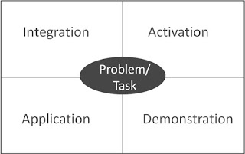
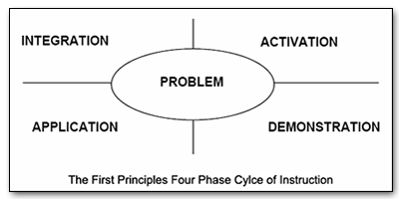
Merrill’s First Principles of Teaching/Instruction http://travelinedman.blogspot.com/2011/05/bonks-last-principles-of-instruction.html

Slide 3
Bonk's Last Principles of Teaching/Instruction (Education 4.0?) http://travelinedman.blogspot.com/2011/05/bonks-last-principles-of-instruction.html http://www.applicadthai.com/articles/education-4-0/

Slide 4
Bonk's 20 "Last" Principles of Instruction (LAST = Learning Activation System Template) http://travelinedman.blogspot.com/2011/05/bonks-last-principles-of-instruction.html
Choice and Options
Support and Feedback
Flexibility
Nontraditional Learning
Spontaneity
Passion and Inspiration
Convenience
Collegiality
Organization
Relevance and Meaningfulness
Sharing
Trial and Error (i.e., it is ok to fail)
Cheerfulness and Optimism
Purpose and Vision
Expanded Resources
High Expectations
#20 ???
Human Connectedness
Empowerment and Autonomy
Cognitive Apprenticeship

Slide 5
Education 20/20

Slide 6
20 New Roles of the Instructor
Course Ambassador
Captain
Consumer Advocate
Curator
Counselor
Cook
Change Catalyst
Concierge
Conductor
Comedian
Camping Trip Guide
Consultant
Coach
Course Expedition Leader
Collaborator
Community Organizer
Chemist
Care Giver
Cultivator
Colleague

Slide 9
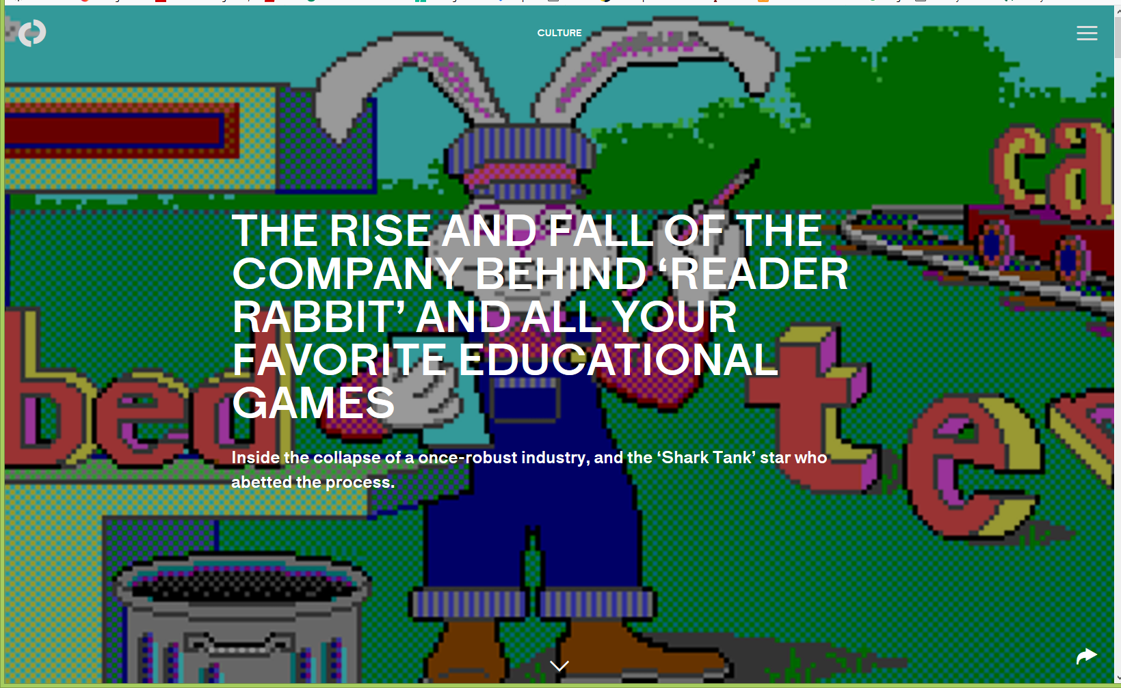
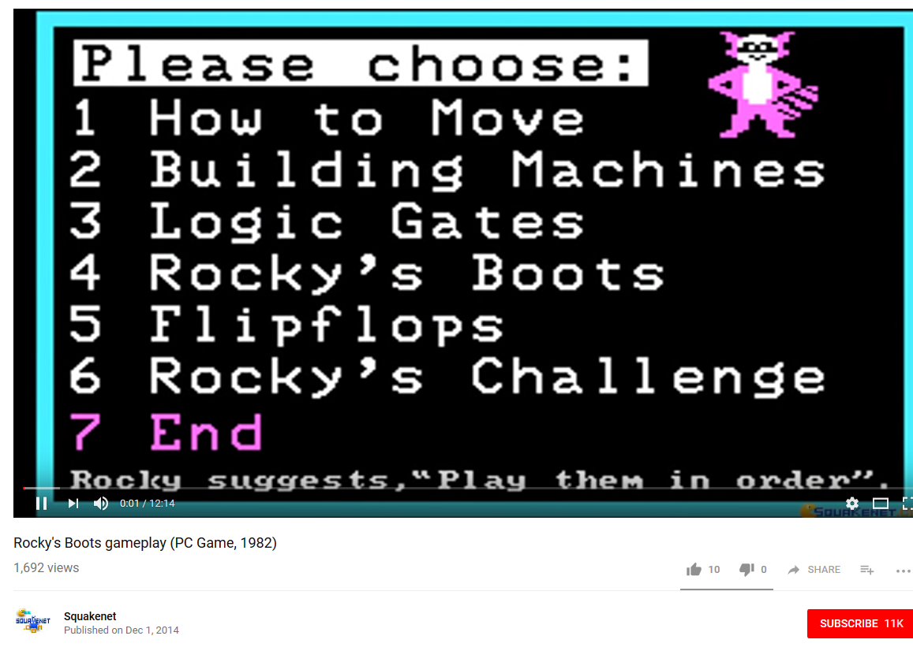
September 26, 2018 Remember Education 2.0? The rise and fall of the company behind ‘Reader Rabbit’ and all your favorite educational games Abigail Cain, The Outline https://theoutline.com/post/6293/reader-rabbit-history-the-learning-company-zoombinis-carmen-sandiego?zd=1&zi=qmbuobk7 Rocky’s Boots: https://www.youtube.com/watch?v=a-NLh58bIIk Project YES (Curt Bonk): https://youtu.be/bZD5mQH4Ups

Slide 10
Fast Forward 30+ More Years… “Anyone can now learn anything from anyone at any time.”

Slide 11
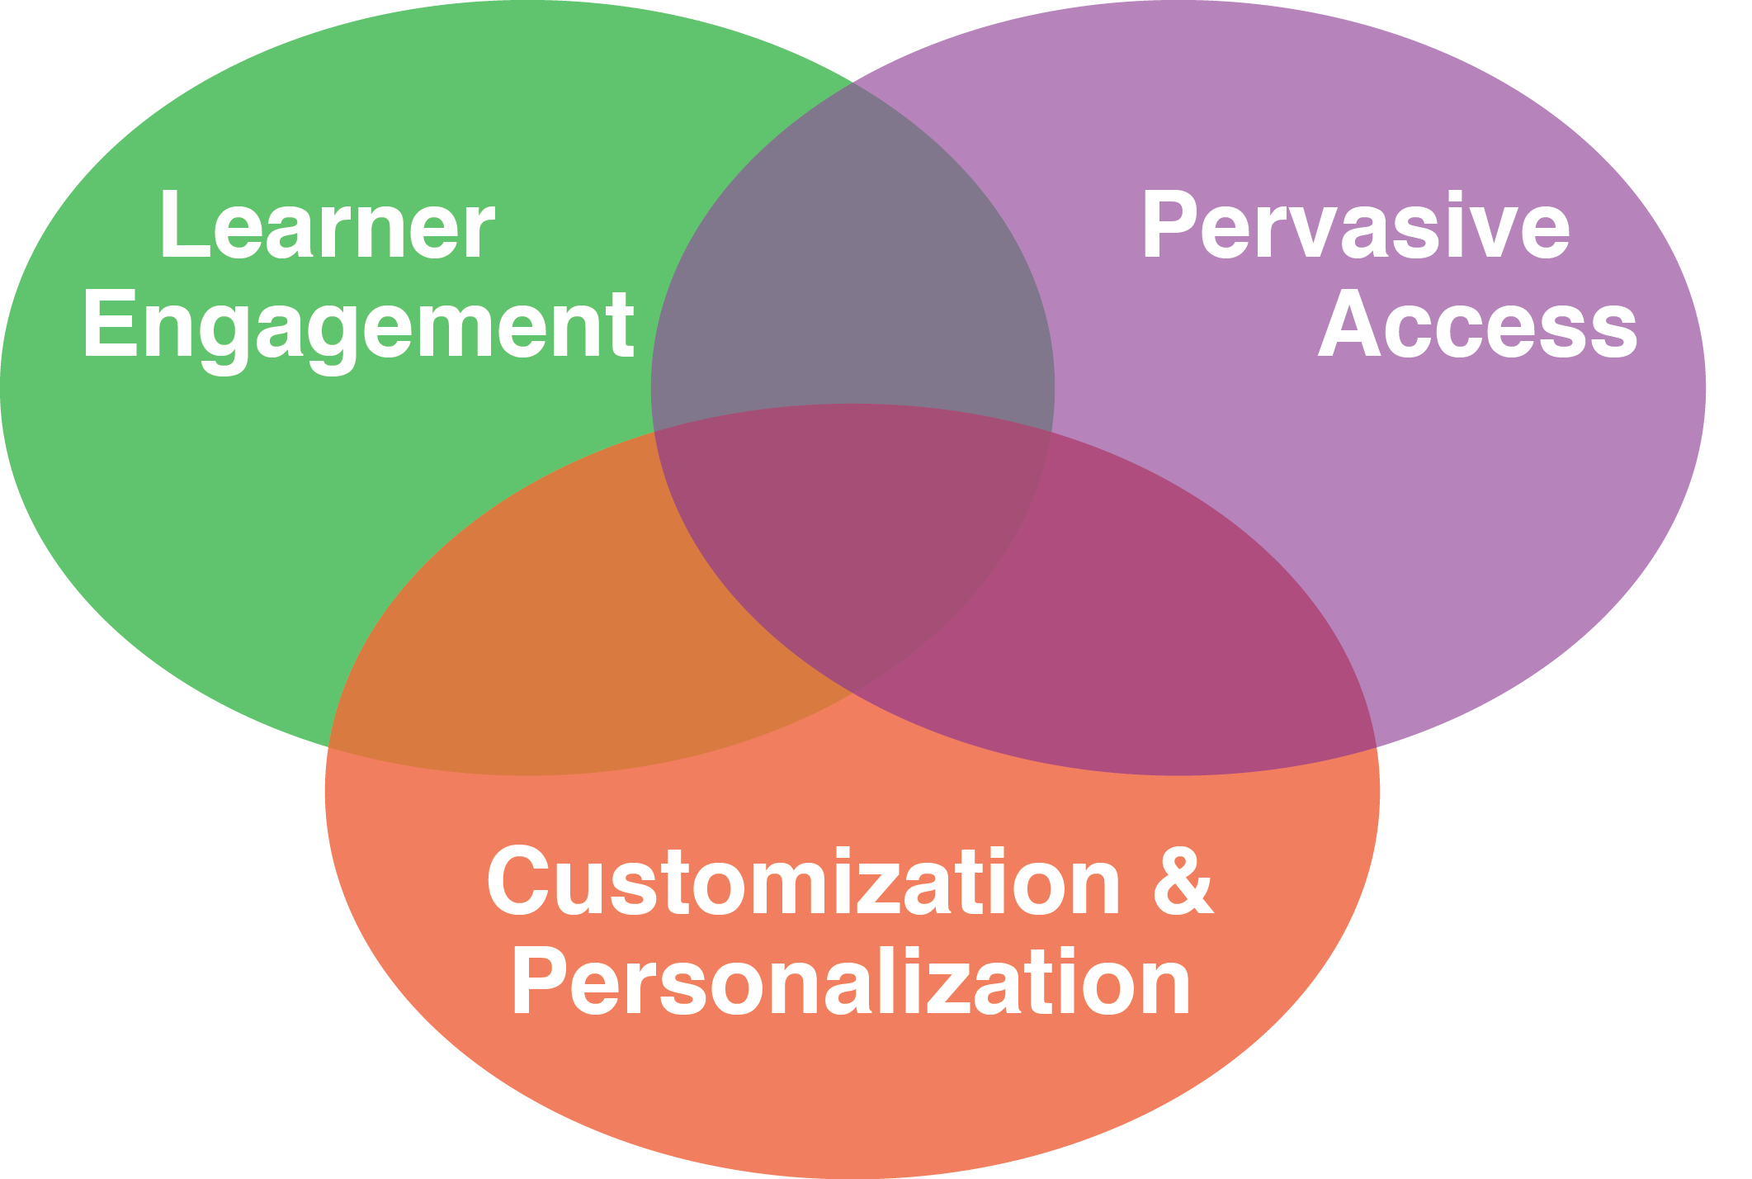
30+ Ways Learning is Changing: The Mega Trends

Slide 12
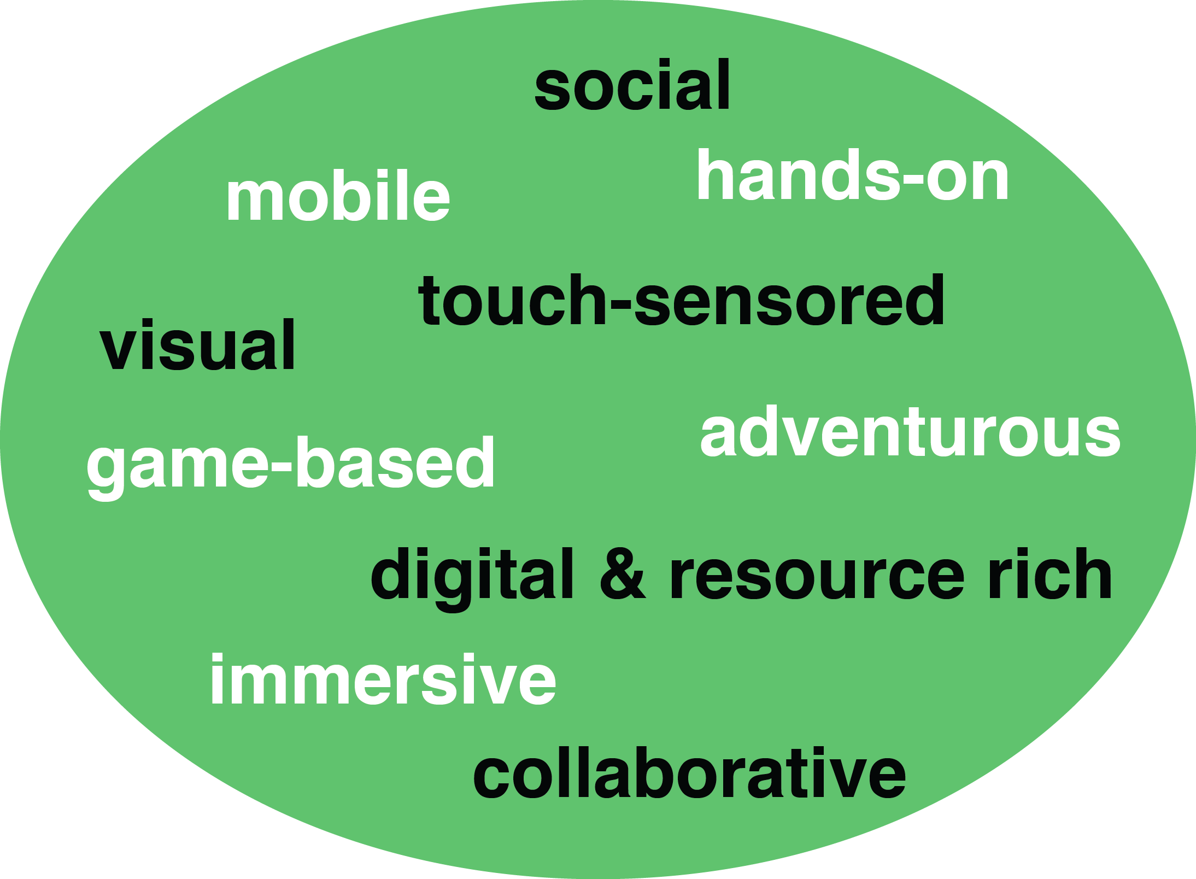
How Learning is Changing: Mega Trend #1. Learner Engagement

Slide 13
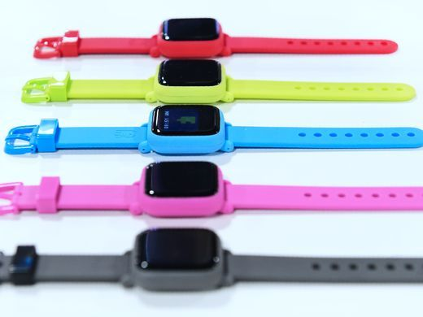
January 3, 2018 Learning is More Mobile CES 2018: Your guide to the biggest consumer electronics show USA Today https://www.usatoday.com/story/tech/news/2018/01/03/ces-2018-your-guide-biggest-consumer-electronics-show/1000778001/
The Octopus watch from Joy, an icon-based watch for kids to have good habits is on display during CES.

Slide 14
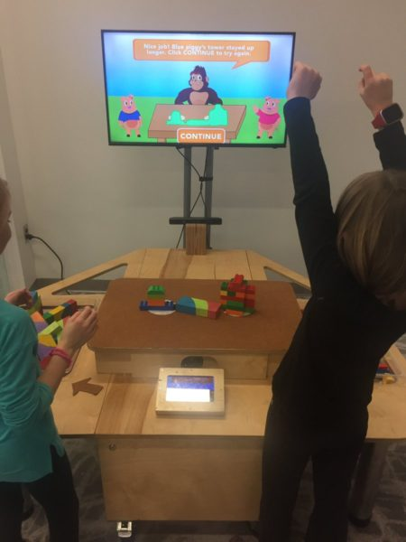
May 1, 2018 Learning is More Hands-on 3 ways districts can use AR and AI Justin Anglio, eSchool News https://www.eschoolnews.com/2018/05/01/3-amazing-ways-our-district-is-using-ar-and-vr/
EarthShake, the first educational game for the NoRILLA system, teaches early physics principles through hands-on learning.

Slide 15
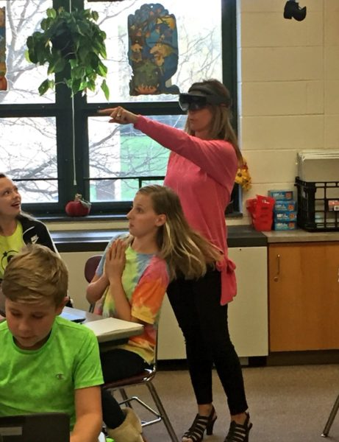
May 1, 2018 Learning is More Immersive 3 ways districts can use AR and AI Justin Anglio, eSchool News https://www.eschoolnews.com/2018/05/01/3-amazing-ways-our-district-is-using-ar-and-vr/
When a teacher glances around her classroom, Lumilo allows her to see real-time analytics (in the form of icons) floating directly above each student’s head. The teacher can glance directly at a student or “click” on a student’s icon to see more detailed information about where and how that student might be struggling.

Slide 16
July 19, 2017 Learning is More Immersive HoloLens Assists in Live Surgery Tommy Palladino, Next Reality https://hololens.reality.news/news/hololens-assists-live-surgery-0178887/ Video #1: 1:09: http://curtbonk.com/hololens.html Video #2: 1:37: http://curtbonk.com/hololens2.html 07/19/2017 HoloLens Assists in Live Surgery Numerous examples exist of doctors and surgeons using HoloLens to plan surgeries. The device has even been used to view reference images during a procedure and stream it to a remote audience. Until recently, it has not been used to augment the surgeon's view of the patient during a live surgery. Original Video: https://hololens.reality.news/news/hololens-assists-live-surgery-0178887/

Slide 17
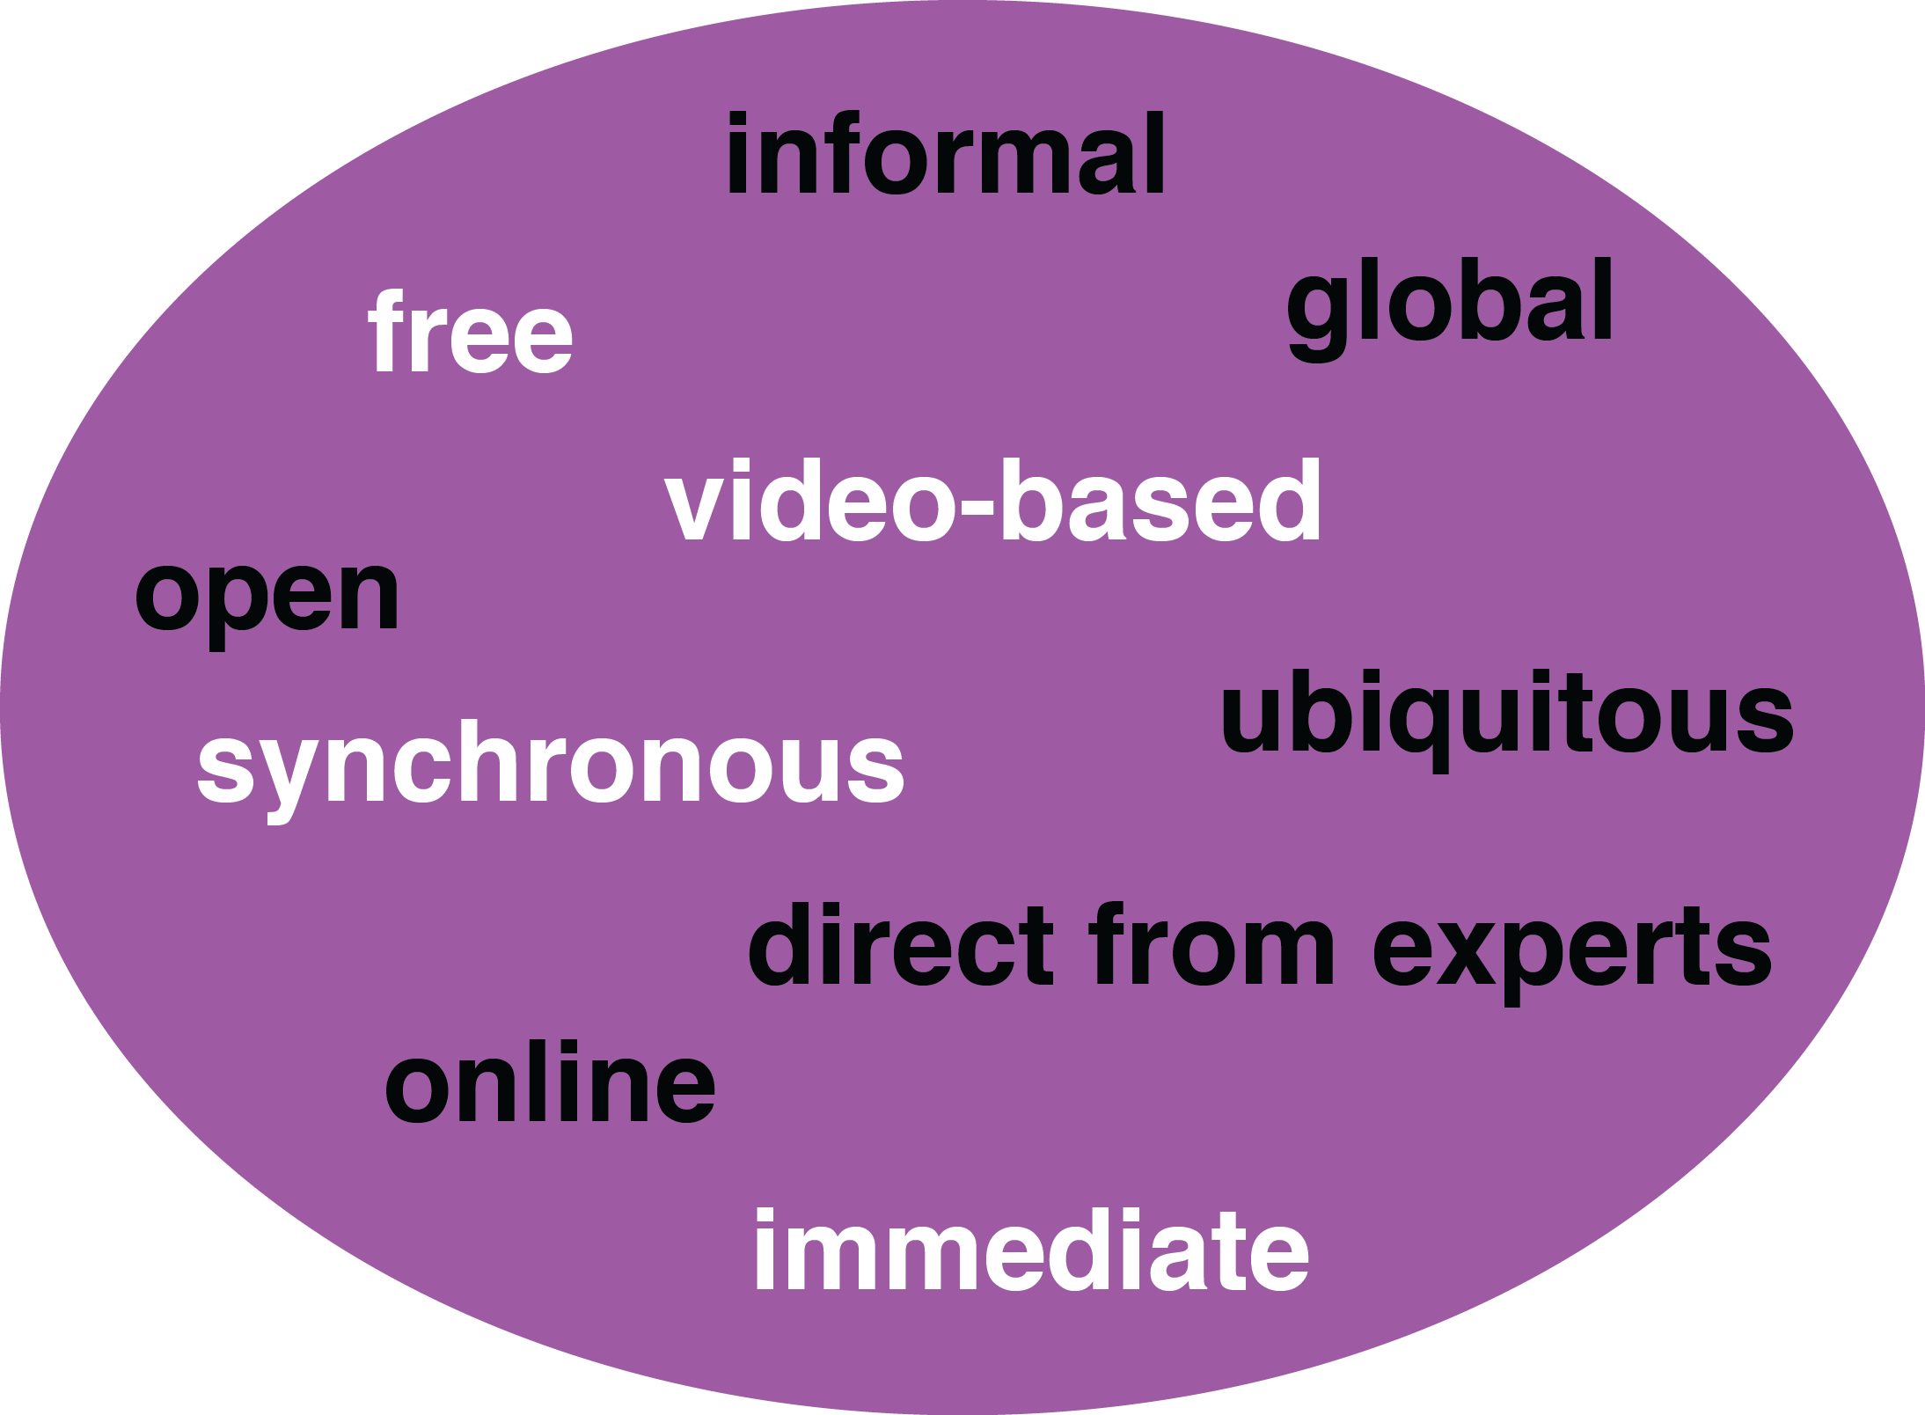
How Learning is Changing: Mega Trend #2. Pervasive Access

Slide 18
November 1, 2017 Learning is More Online (Access) Indiana University, Office of Online Education

Slide 19
December 19, 2017 OER Adoptions on the Rise Lindsay McKenzie, Inside Higher Ed https://www.insidehighered.com/news/2017/12/19/more-faculty-members-are-using-oer-survey-finds

Slide 20
March 27, 2017 (Access) Learning is More Free and Open Beyond Free: Harnessing the resonant value in open and collaborative practices for the public good David Porter, CEO, eCampus Ontario, Open Education Ontario Summit https://www.slideshare.net/David_Porter https://www.ocls.ca/events/open-education-ontario-summit

Slide 21
May 7, 2014 (Access) Learning is More Global CNA - Speaking Exchange (video chats) https://www.youtube.com/watch?v=-S-5EfwpFOk FCB Brazil and the CNA language school network are launching the Speaking Exchange project, which connects CNA students in Brazil with Americans living in retirement homes.

Slide 22
July 29, 2018 Learning is More Synchronous Why Silicon Valley is teaming up with San Quentin to train young people to code Jessica Guynn and Megan Diskin, USA TODAY https://www.usatoday.com/story/tech/2018/07/25/california-youth-learning-code-prison-help-san-quentin-inmates/810122002/ Video (1:46): http://curtbonk.com/san-quentin.html

Slide 23
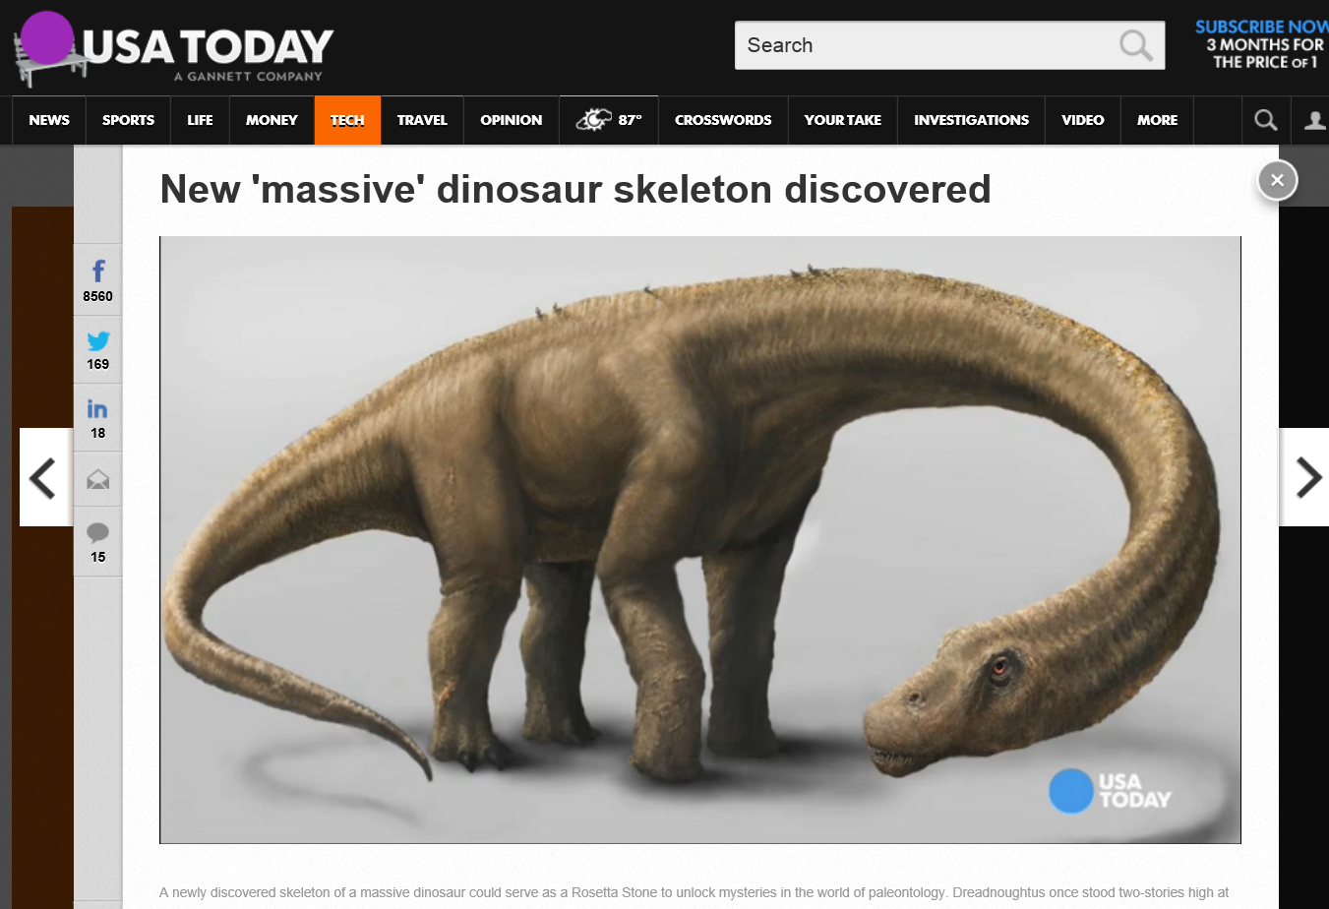
January 5, 2017 Learning is More Immediate… Move over T. rex, new dinosaur unveiled, Amanda Jackson, CNN http://www.cnn.com/2016/01/14/living/titanosaur-new-dinosaur-on-display-new-york-irpt/

Slide 24
September 27, 2018 Learning is More Immediate… Dinosaur Discoveries New 26,000-pound dinosaur discovery was Earth's largest land animal Ashley Strickland, CNN https://www.cnn.com/2018/09/27/world/new-giant-dinosaur-brontosaurus-relative/index.html

Slide 25
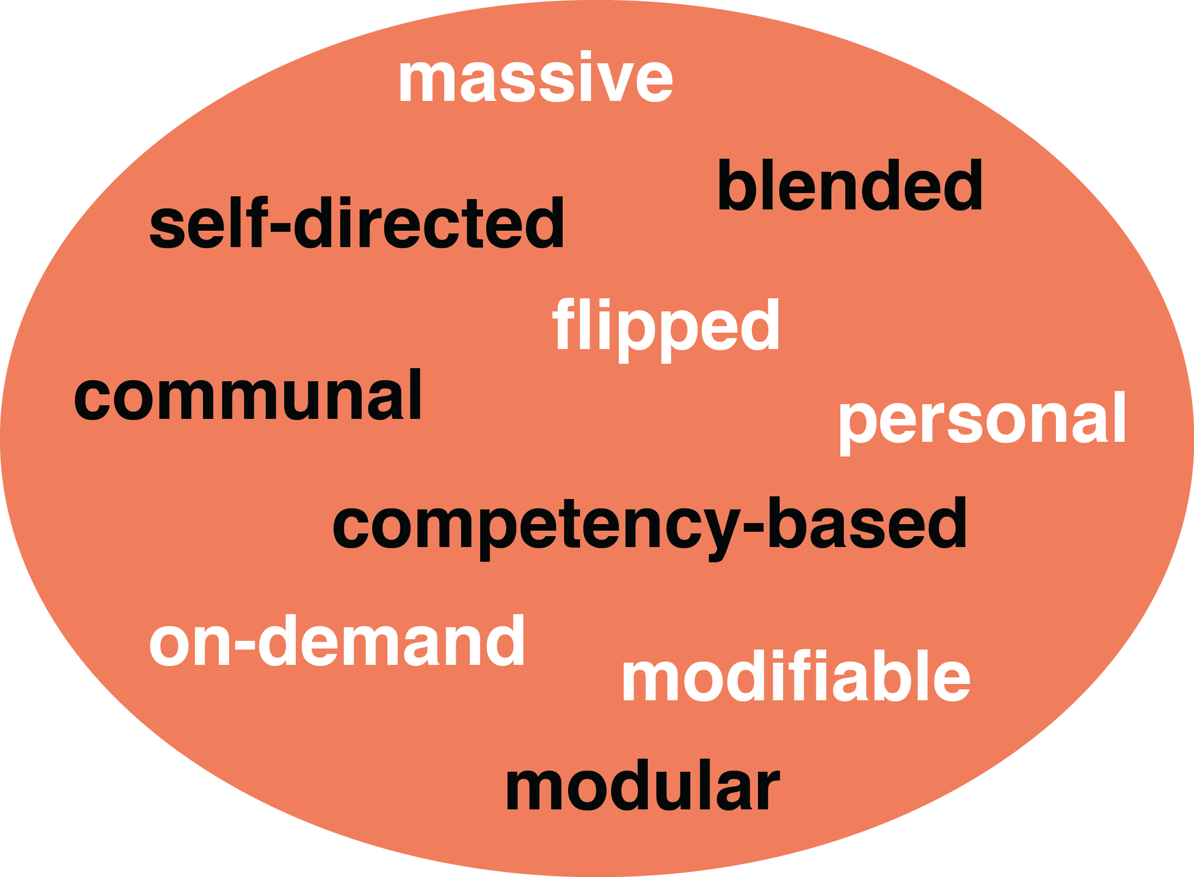
How Learning is Changing: Mega Trend #3. Customization

Slide 26
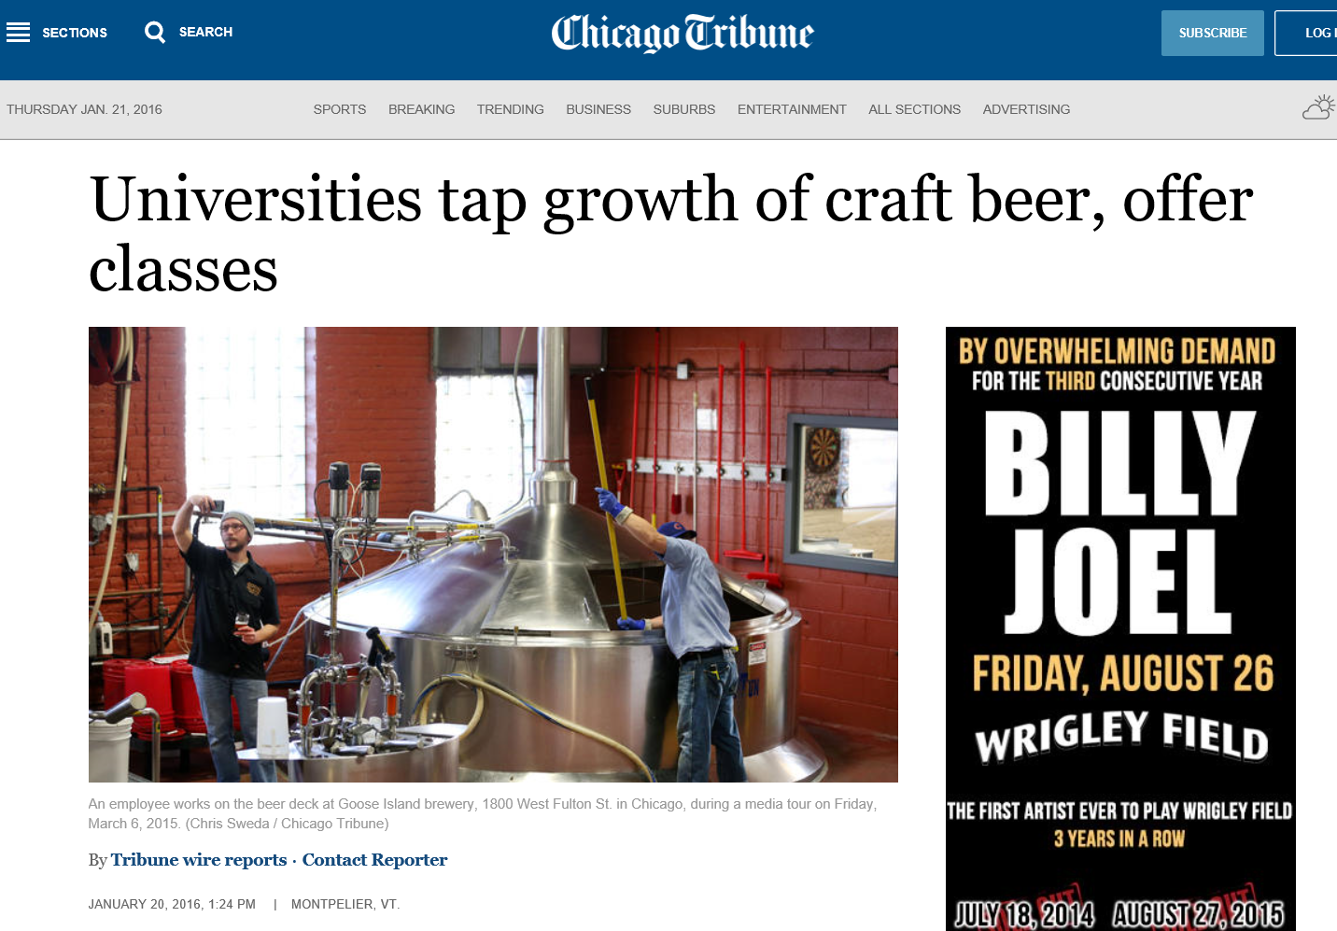
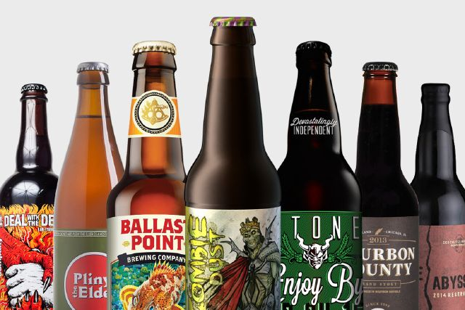
January 20, 2016 Learning is More Blended Universities tap growth of craft beer, offer classes, Chicago Tribune http://www.chicagotribune.com/business/ct-college-craft-beer-offer-classes-20160120-story.html

Slide 27
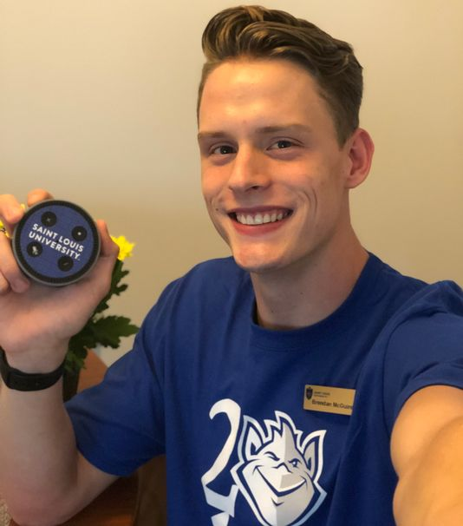
August 2, 2018 Learning is More On Demand (PDAs) Hey, Alexa, Should We Bring Virtual Assistants to Campus? These Colleges Gave Them a Shot Lindsey Ellis, The Chronicle of Higher Education https://www.chronicle.com/article/Hey-Alexa-Should-We-Bring/244129 24 seconds: http://curtbonk.com/jetsons24.html 44 Seconds: http://curtbonk.com/jetsons44.html

Slide 28
January 9, 2017 Learning is More On Demand Jill Watson, Round Three, Georgia Tech course prepares for third semester with virtual teaching assistants, Jason Maderer, Georgia Tech News Center http://www.news.gatech.edu/2017/01/09/jill-watson-round-three The Terribly Thin Conception of Ethics in Digital Technology, David Golumbia, Uncomputing http://www.uncomputing.org/ Bot teacher that impressed and fooled everyone, Donald Clark, Plan B http://donaldclarkplanb.blogspot.co.uk/2016/12/bot-teacher-that-impressed-and-fooled.html

Slide 29
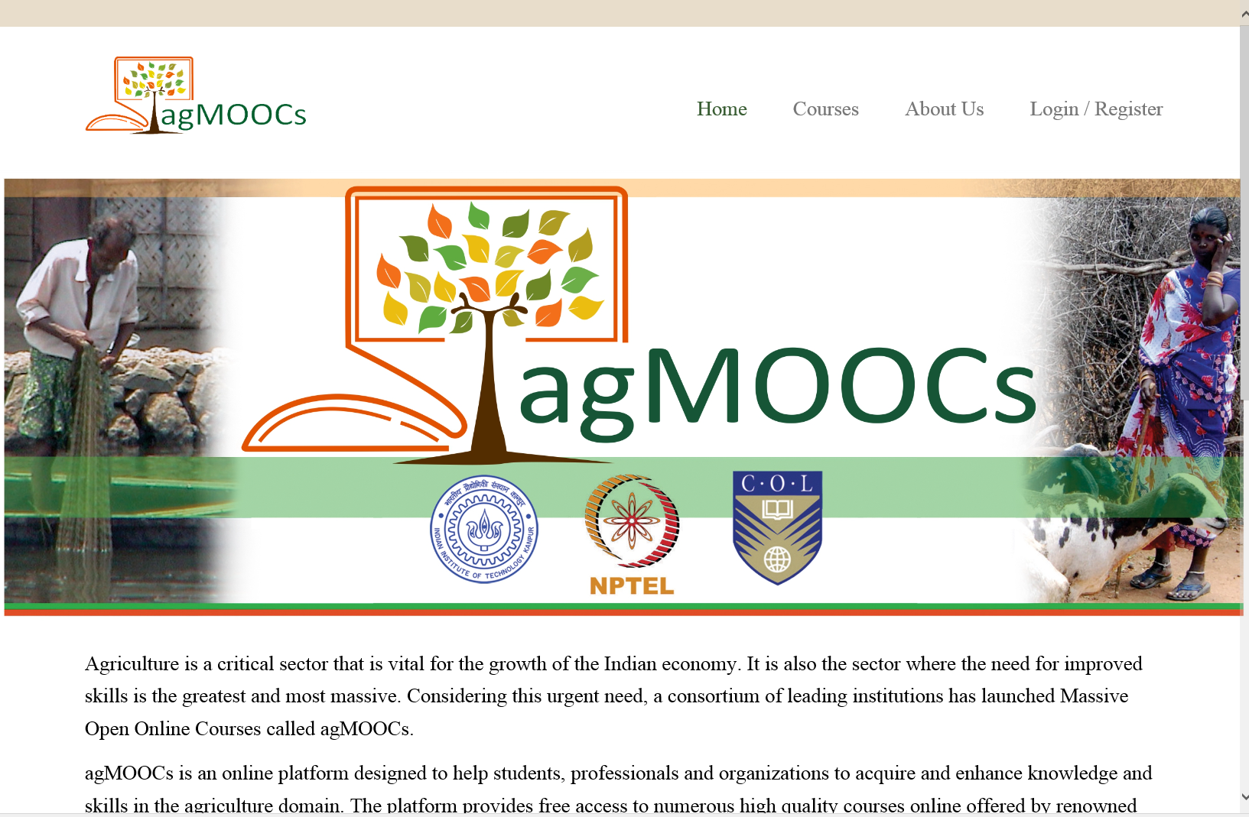
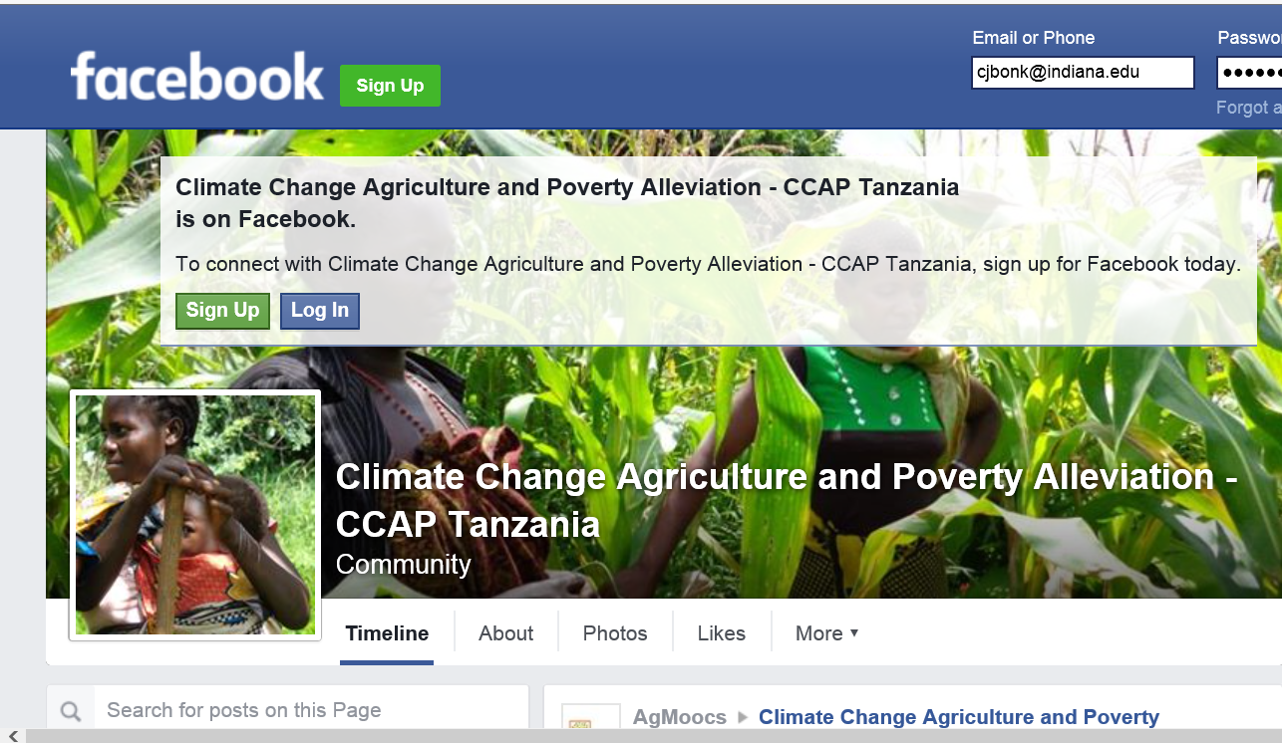
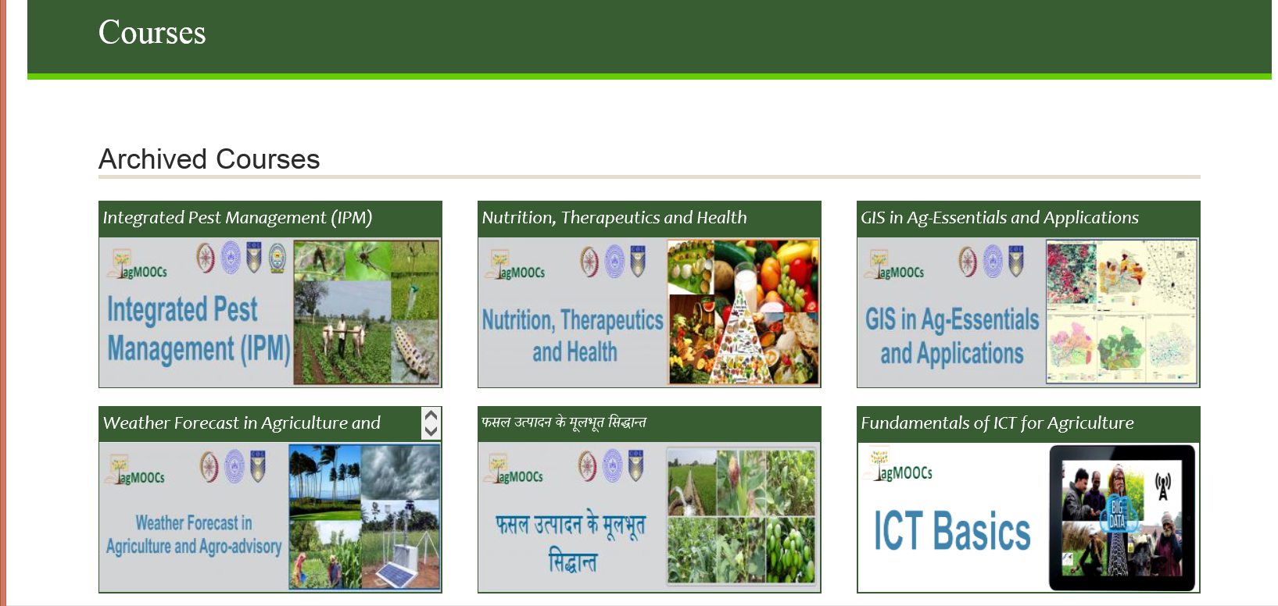
May 20, 2016 Chapter 18: Changing the Tune: MOOCs for Human Development? A Case Study (agMOOCs in India) Balaji Venkataraman and Asha Kanwar (COL) http://www.agmoocs.in/

Slide 30
MOOCs are Like Library Books…

Slide 31
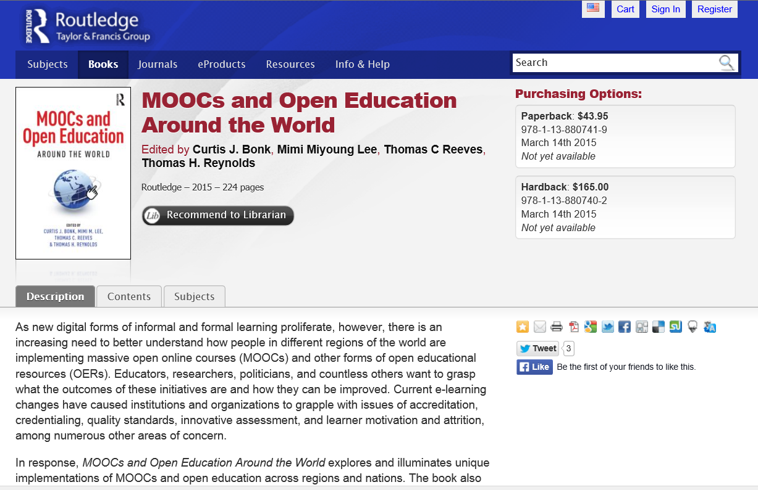
MOOCs and Open Education Around the World http://routledge-ny.com/books/details/9781138807419/

Slide 32
Talk Outline
MOOC Weird Stuff
MOOC Systematic Literature Review
MOOC ID Considerations and Challenges
MOOC ID for Self-directed Learning
Others

Slide 33
Polls
Poll #1: Who in here has taken a MOOC? Poll #2: Are you happy or frustrated when you take a MOOC?

Slide 34
Some Weird Things Going On…

Slide 35
Weirdness #1…We’re Teaching the World October, 2018 Sarah Fister Gale, CLO https://magazine.clomedia.com/issue/october-2018/teaching-the-world/ https://magazine.clomedia.com/issue/october-2018/

Slide 36
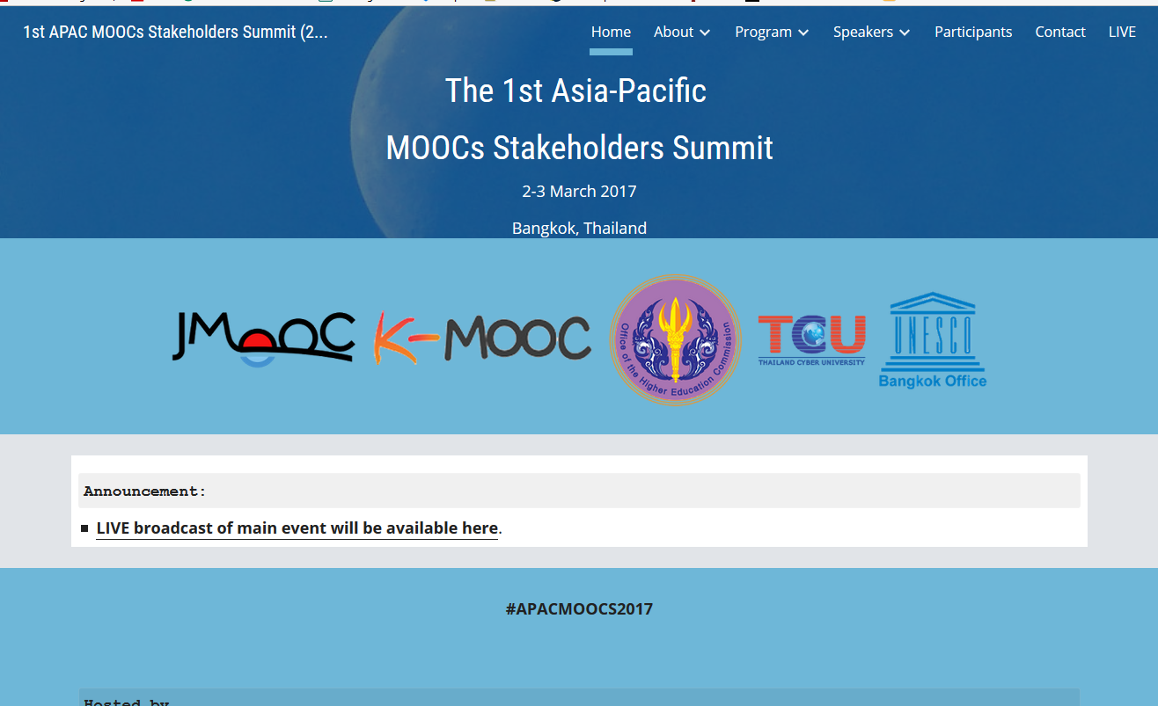
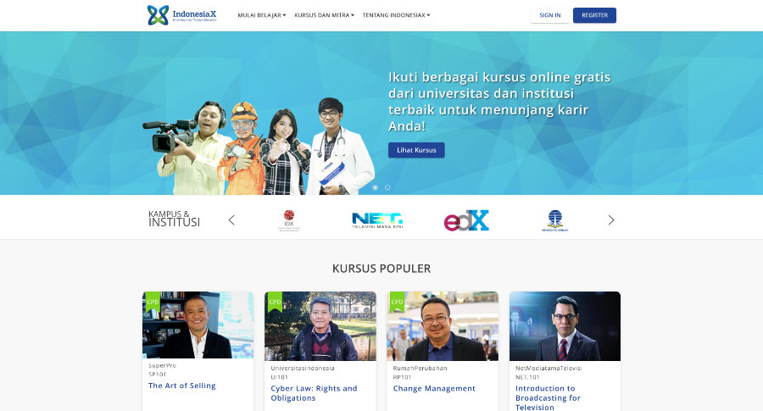
Weirdness #2: Your Friends are doing MOOCs June 15, 2017 Massive List of MOOC Providers Around The World, Class Central JMOOC, K-MOOC, and T-MOOC? https://www.class-central.com/report/mooc-providers-list/

Slide 37
Weirdness #3: Summer MOOC Discounts Email inbox: June 10, 2018 edX (Summer discounts) https://www.edx.org/course

Slide 38
Weirdness #4: Cyber Monday Discounts Email inbox: November 26, 2018 edX (Summer discounts) https://www.edx.org/course

Slide 39
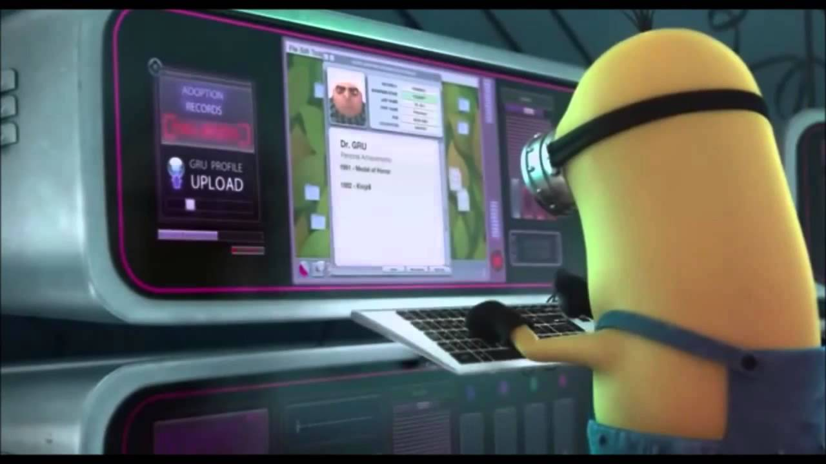
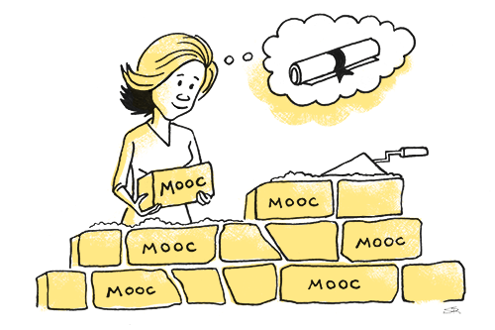
Weirdness #5…The MOOC Wave May 21, 2018 The Second ave of MOOC Hype Is Here, and It’s Online Degrees Dhawal Shah, Class Central https://www.edsurge.com/news/2018-05-21-the-second-wave-of-mooc-hype-is-here-and-it-s-online-degrees

Slide 40
September 12, 2018 Coursera's CEO on the Evolving Meaning of 'MOOC’ Dian Schaffhauser, Campus Technology https://campustechnology.com/articles/2018/09/12/courseras-ceo-on-the-evolving-meaning-of-mooc.aspx
Jeff Maggioncalda, Coursera CEO

Slide 41
October 12, 2018 Weirdness #6…Degrees Via the MOOC EdX: From MicroMasters to Online Master’s Degrees Lindsey McKenzie, Inside Higher Ed https://www.insidehighered.com/news/2018/10/12/edx-launches-nine-low-cost-online-degrees

Slide 42
Weirdness #7…MOOCs in Wedding Announcements September 26, 2018 The Future of Professional Credentialing ... in an Engagement Announcement Joshua Kim, Inside Higher Ed https://www.insidehighered.com/digital-learning/blogs/technology-and-learning/future-professional-credentialing-engagement

Slide 43
Weirdness #8…Master’s of Accountancy MOOCs? Email inbox: June 11, 2018 Coursera https://www.coursera.org/

Slide 44
Weirdness #9…Discounted MOOC-based MBAs August 7, 2017 FutureLearn and Coventry University to Roll Out 50 Online Degrees (Last year Deakin University announced a similar partnership with FutureLearn) Class Central, Dhawal Shah https://www.class-central.com/report/futurelearn-coventry-university-roll-50-online-degrees/

Slide 45
Weirdness #10…MOOC-based Pricing Charts December 30, 2018 MOOC-Based Degrees, Pricing Chart IBL News https://www.class-central.com/pricing-charts/mooc-based-degrees

Slide 46
August 12, 2016 A Life of Happiness and Fulfillment Indian School of Business, Rajagopal Raghanathan https://www.class-central.com/mooc/2860/coursera-a-life-of-happiness-and-fulfillment

Slide 47
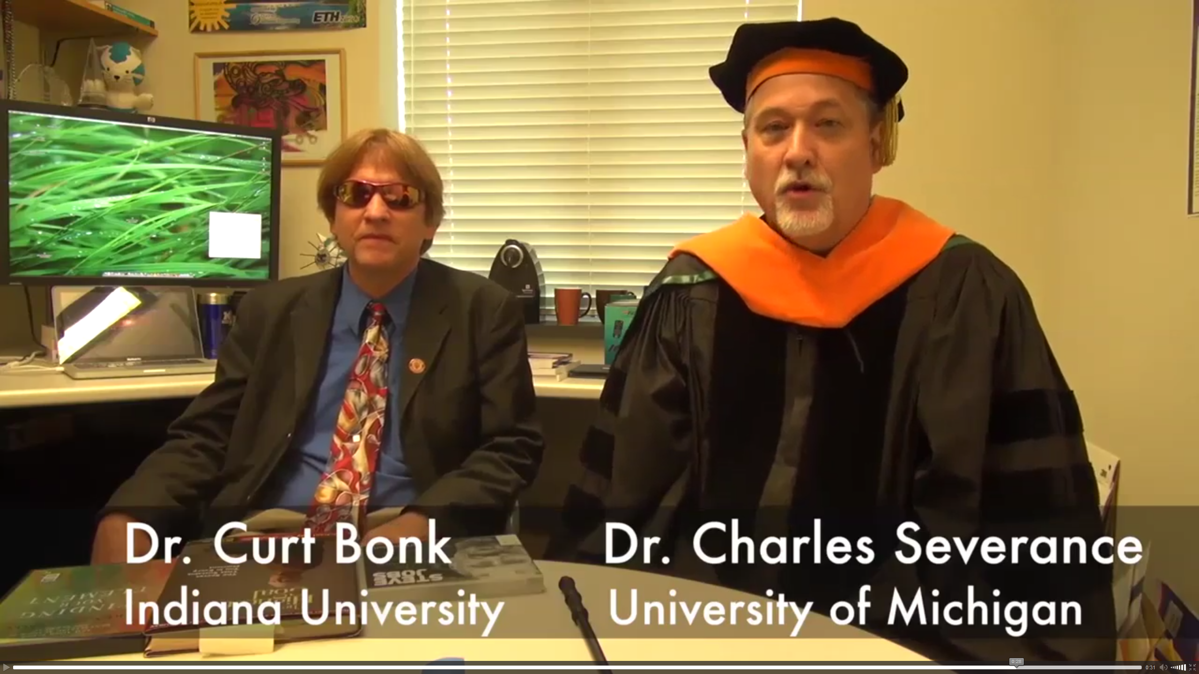
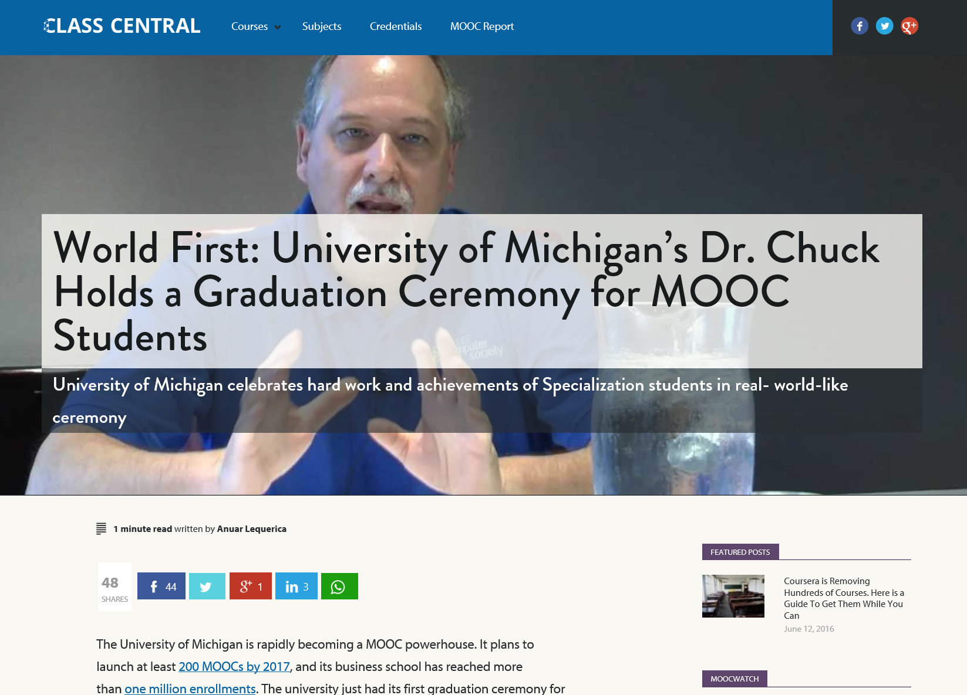
June 14, 2016 (Customization) Chapter 15: Learning About MOOCs by Talking to Students Charles Severance, Univ. of Michigan Anuar Lequerica, Class Central https://www.class-central.com/report/dr-chuck-graduate-ceremony-python-specialization/

Slide 48
MOOC Trends and Recent Data

Slide 49
MOOCs are not dead August 19, 2018 Cumulative Growth in Number of MOOCs, 2011-18 Almanac 2018, Chronicle of Higher Education https://www.chronicle.com/article/Top-5-MOOC-Providers-by-Number/244090?cid=cp216

Slide 50
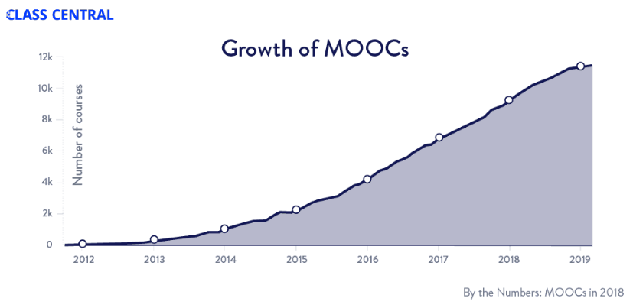
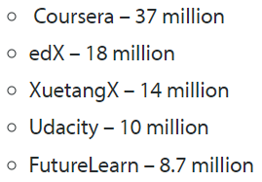
MOOCs Trends
Year of MOOC-based Degrees: A Review of MOOC Stats and Trends in 2018, Dhawal Shah, Class Central--January 6, 2019
Top five MOOC providers

Slide 51
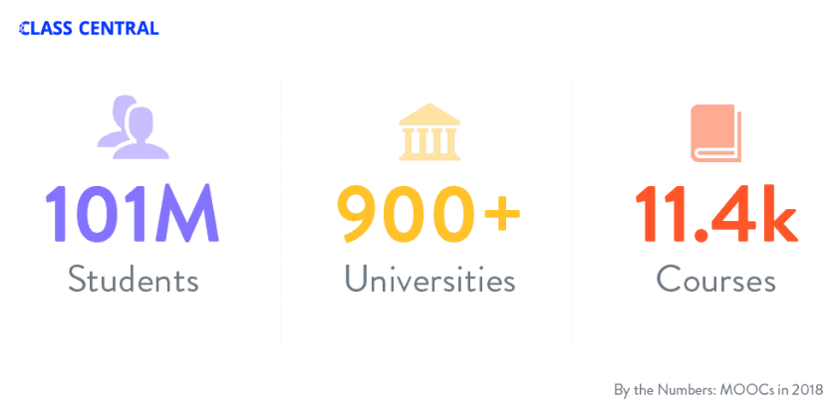
MOOCs Stats
Year of MOOC-based Degrees: A Review of MOOC Stats and Trends in 2018, Dhawal Shah, Class Central--January 6, 2019

Slide 52
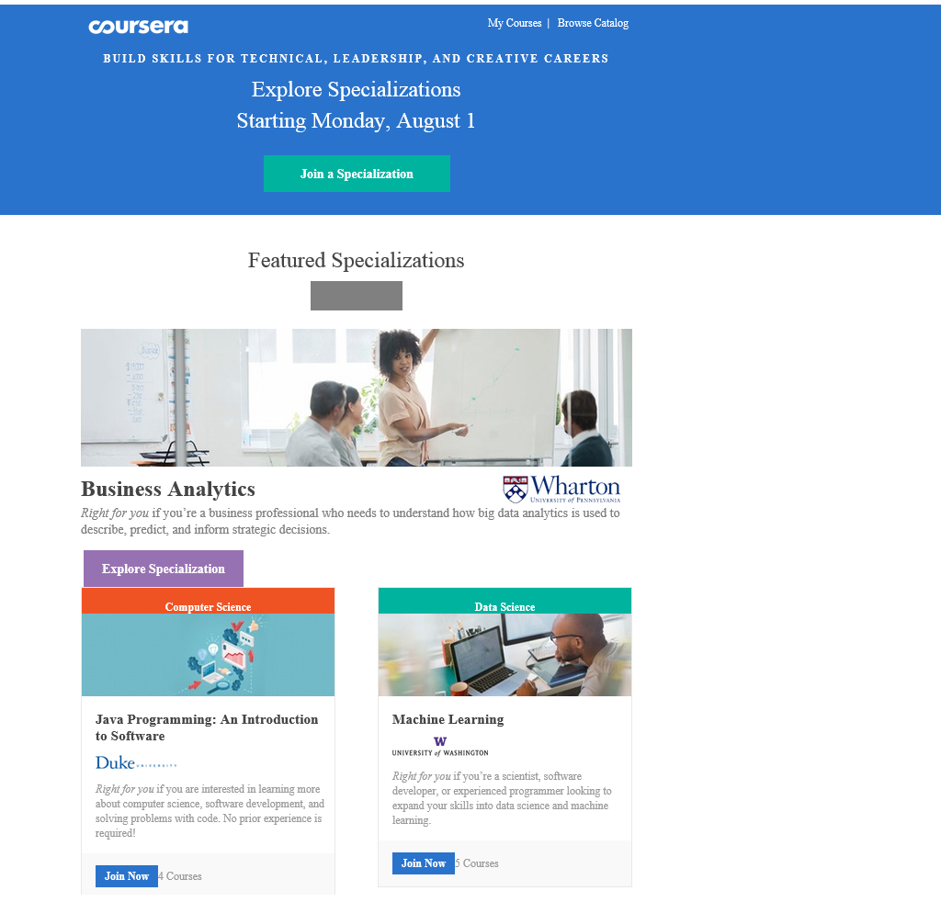
October 12, 2018 Microcredentials and Nanodegrees Learning is More on Modular edX Expands MicroMasters Programs With Data Science (“nanodegrees”) Digital Leadership and More, Sri Ravipati, Campus Technology https://campustechnology.com/articles/2017/03/01/edx-expands-micromasters-programs-with-data-science-digital-leadership-and-more.aspx Lindsey McKenzie, Inside Higher Ed https://www.insidehighered.com/news/2018/10/12/edx-launches-nine-low-cost-online-degrees

Slide 53
January 9, 2018 MicroMaster’s Degrees Learning is More on Modular MIT launches MITx MicroMasters in Principles of Manufacturing, MIT Open Learning http://news.mit.edu/2018/mit-launches-new-mitx-micromasters-program-principles-manufacturing-0109

Slide 54
December 7, 2018 Reinventing the College Degree: A Future with Modular Credentials IBL News https://iblnews.org/2018/12/07/reinventing-the-college-degree-a-future-with-modular-credentials/

Slide 55
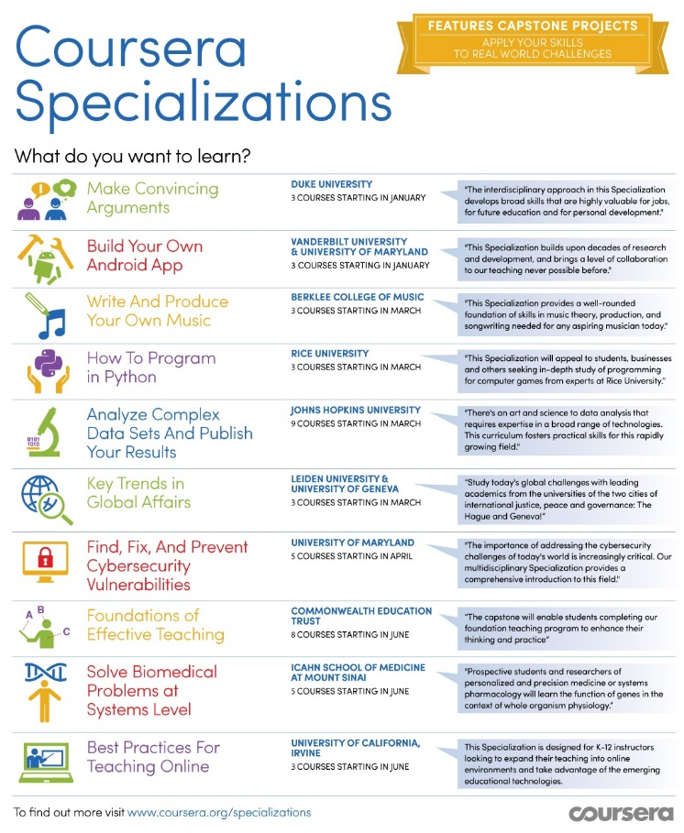
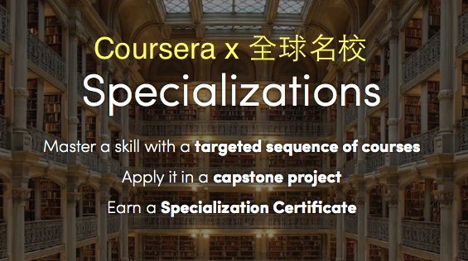
January 20, 2016 Coursera Specializations https://www.coursera.org/browse?utm_medium=email&utm_source=marketing&utm_campaign=aUAR4L-fEeW6i-NodUB9Qw&languages=en

Slide 56
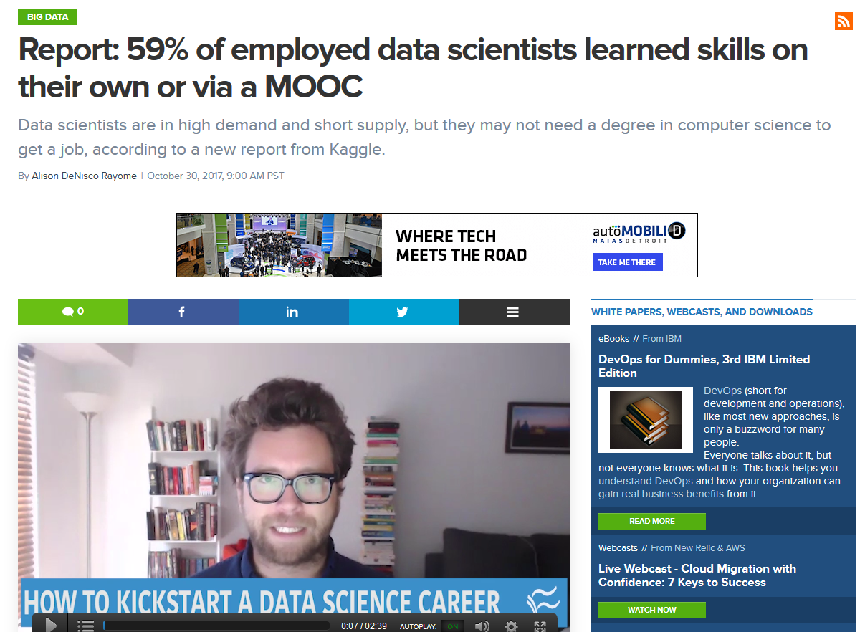
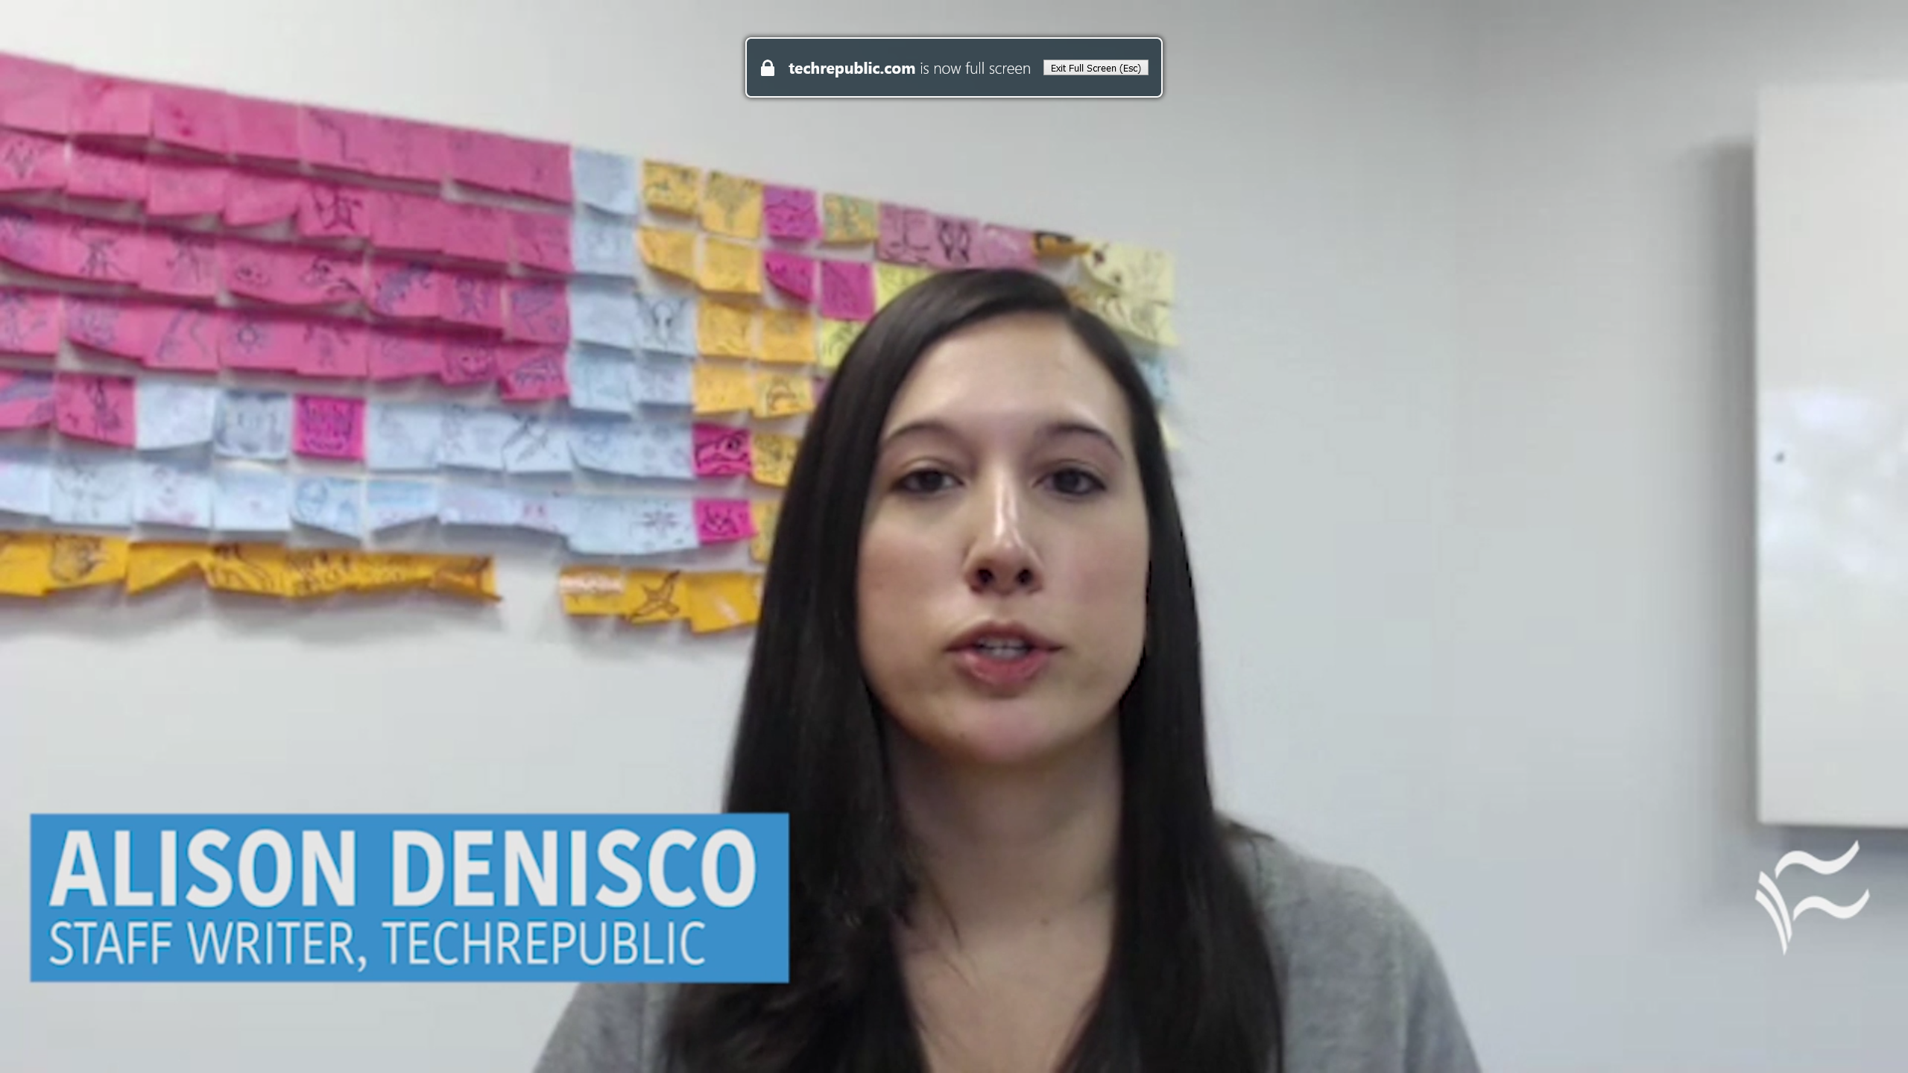
October 30, 2017 MOOCs ramp up new fields Report: 59% of employed data scientists learned skills on their own or via a MOOC Alison DeNisco Rayome https://www.techrepublic.com/article/report-59-of-employed-data-scientists-learned-skills-on-their-own-or-via-a-mooc/

Slide 57
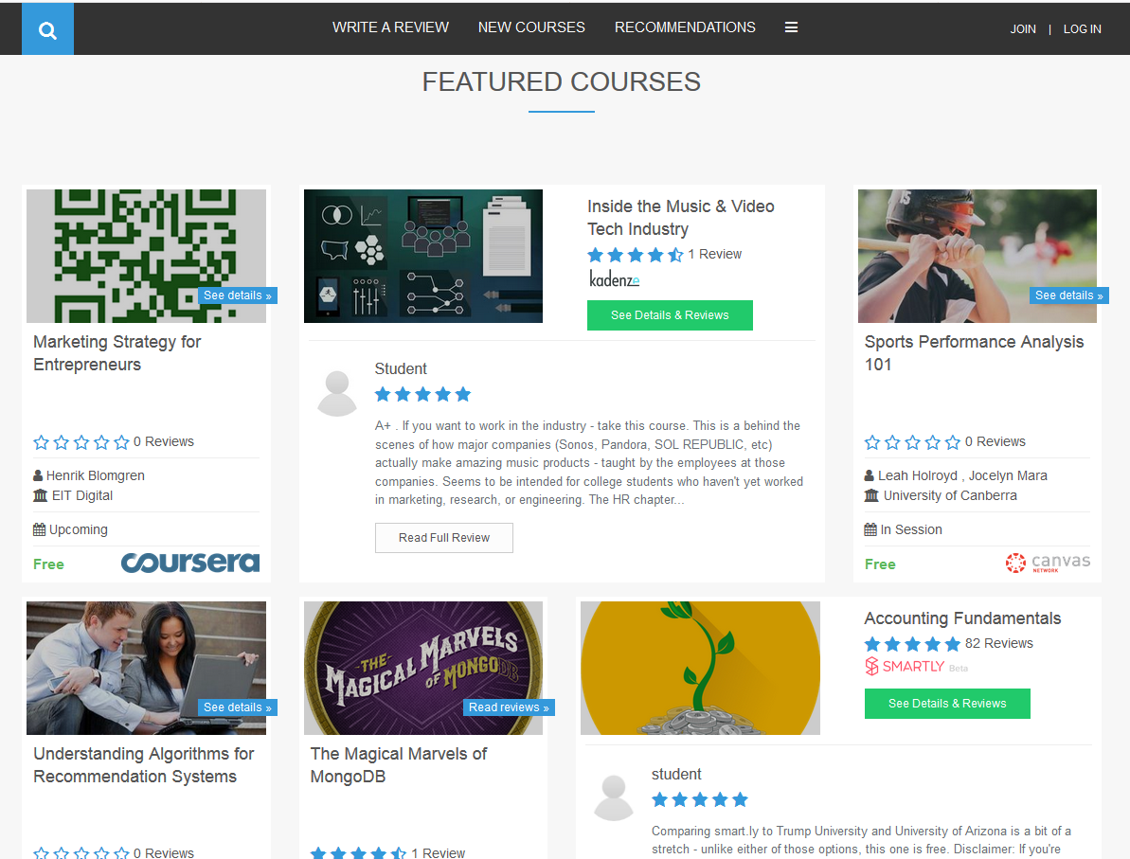
Khe Foon (Timothy) Hew (2018) Hew, K. F. (2018). Unpacking the Strategies of Ten Highly Rated MOOCs: Implications for Engaging Students in Large Online Courses. Teachers College Record, 120(1). https://www.coursetalk.com/
Hew’s (2018, p. 1) analyzed 4,565 coursetalk review comments of 10 highly rated MOOCs. He found “six key factors that can engage online [MOOC] participants and nine reasons for participant disaffection.”
Problem-centric learning supported by clear explanations.
Active learning supported by timely feedback (e.g., assignments, projects, discussion).
Course resources that cater to participants’ learning needs or preferences.
Instructor attributes (e.g., passion, enthusiasm, humor, variety of examples).
Peer interaction.
Instructor availability.

Slide 58
Quotes: Veletsianos et al. (2015-2016)
“To gain a deeper and more diverse understanding of the MOOC phenomenon, researchers need to use multiple research approaches (e.g., ethnography, phenomenology, discourse analysis) add content to them.” (p. 583)
Veletsianos, Collier, & Schneider (2015, May), Digging deeper into learners’ experiences in MOOCs: Participation in social networks outside of MOOCs, notetaking and contexts surrounding content consumption. BJET, 46(3), 570-587.
“Dependence on Particular Research Methods May Restrict our Understanding of MOOCs.”
George Veletsianos & Peter Shepherdson’s Study (2016). Systematic Analysis and Synthesis of the Empirical MOOC Literature Published in 2013-2015. IRRODL. http://www.irrodl.org/index.php/irrodl/article/view/2448/3655

Slide 59
Three Studies
Study #1
MOOC Literature Review
Study #3
MOOC Design for SDL
Study #2
MOOC Design Considerations and Challenges

Slide 60
Study #1 MOOCs Literature Review (2014-2016)
Zhu, M., Sari, A., & Lee, M. M. (2018). A Systematic Review of Research Methods and Topics of the Empirical MOOC Literature (2014-2016). The Internet and Higher Education, 37, 31-39.

Slide 61
Research Purposes & Questions
The purpose was to gain a deeper and more diverse understanding of the current MOOC phenomenon and identify the gap in MOOC empirical studies.
1. What are the research methods researchers employed in empirical MOOC studies?
2. What are the research topics or focuses in MOOC studies?
3. How are researchers of empirical MOOC studies geographically distributed?
4. In terms of the delivery of the MOOC, what are the countries which are attracting the most research?

Slide 62
Journals of the Articles
No. | Journal | Total
1 | International Review of Research in Open and Distance Learning (IRRODL) | 31
2 | Computers & Education | 12
3 | British Journal of Educational Technology | 9
4 | Online Learning | 7
5 | Distance Education | 5
6 | Educational Media International | 5
7 | Internet and Higher Education | 5
8 | Journal of Computer Assisted Learning | 5
9 | Computers in Human Behavior | 4
10 | Open Learning | 4
11 | Journal of Online Learning and Teaching | 3
12 | Journal of Asynchronous Learning Network | 3

Slide 63
RQ1 & RQ2
MOOC research focuses and methods
 | Quantitative | Qualitative | Mixed methods
Student-focused | 39 | 9 | 26
Design-focused | 19 | 12 | 17
Context and impact | 9 | 6 | 5
Instructor-focused | 0 | 3 | 2

Slide 64
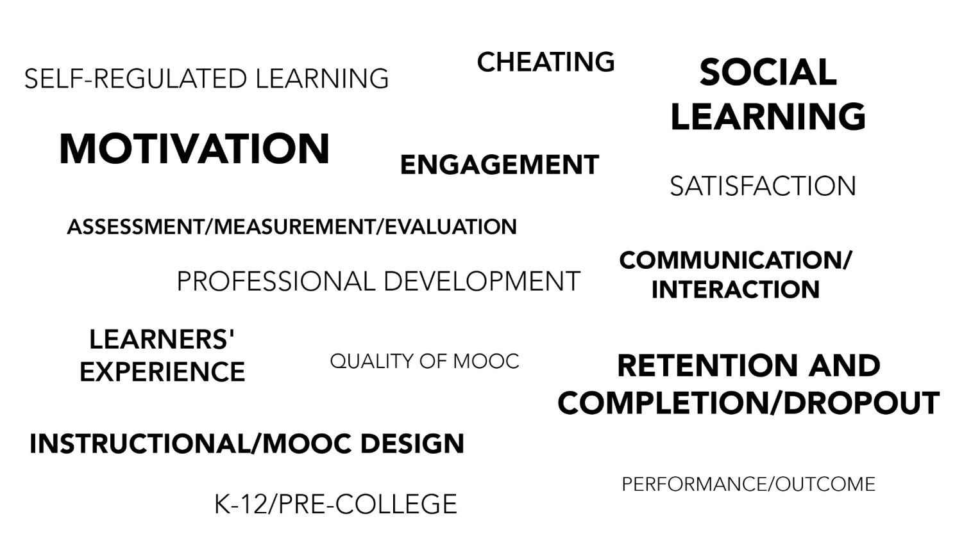
RQ2
Specific Focus of MOOC Research (2014-2016)

Slide 65
RQ3 Locations
Location of MOOC Research Team Members (2014-2016)

Slide 66
Implications
A continuous expansion of methodological approaches in MOOCs research is needed.
More empirical MOOC research focusing on instructors’ perspective might provide more comprehensive picture of MOOC phenomenon.
(Note: Data collection is continuing…)

Slide 67
The study expanded!

Slide 68
Total Number of Empirical MOOC Studies Published in Different Journals from 2013-2018
Table 1
(Note: the table only includes the top nine journals in terms of the number of empirical MOOC studies)
Journals | Number of empirical studies
International Review of Research in Open and Distributed Learning | 51
Computers & Education | 22
British Journal of Educational Technology | 15
Online Learning | 12
Distance Education | 11
Journal of Online Learning and Teaching | 11
The Internet and Higher Education | 10
Computers in Human Behavior | 10
Open Learning | 8

Slide 69
Research Methods
Figure 2. Research methods used in empirical MOOCs studies from 2013-2018 (N=321 studies)

Slide 70
Data Collection Methods
Figure 5. Data collection methods used in empirical MOOCs studies from 2013-2018 (N = 321 studies)
(Note: some studies contain more than one data collection method and this figure only includes the main data collection methods)

Slide 71
Study #2 MOOCs Design Considerations and Challenges
Zhu, M., Bonk, C. J., & Sari, A. (2018). Instructor experiences designing MOOCs in higher education: Pedagogical, resource, and logistical considerations and challenges. Online Learning, 22(4), 203-241.

Slide 72
Research Background
MOOCs can be beneficial to both learners and instructors (Hew & Cheung, 2014).
Instructional design is critical for online learning (Johnson & Aragon, 2003; Phipps & Merisotis, 1999).
Instructors are one of the five main components of MOOCs (Kop, 2011).
Few studies have examined instructional design from MOOC instructors’ perspectives (Margaryan et al., 2015; Watson et al., 2016).

Slide 73
Research Purpose
The purpose of this study is to provide suggestions for future MOOC instructors and instructional designers in higher education through exploring MOOC design considerations and challenges from the instructor’s perspective.

Slide 74
Research Questions
What are the design considerations of instructors when designing MOOCs?
What challenges do instructors perceive when designing MOOCs?
How do instructors address the challenges that they perceive related to MOOCs?

Slide 75
Research Design
Sequential mixed methods design (Creswell & Clark, 2017)
Quan
Data Collection
Quan
Data Analysis
Qual
Data Collection
Interpretation of Entire Analysis
Qual
Data Analysis

Slide 76
Data Collection
Data Collection:
Survey, interview, and course review
Participants:
143 survey participants (10% response rate)
12 interviewees

Slide 77
12 Interviewees
No. | Countries | Subject areas | Platforms
1. | The U.S. | Language and Literacy | Coursera
2. | The U.S. | Education | Coursera
3. | The U.S. | Education | Canvas
4. | The U.S. | Chemistry | Coursera
5. | UK | Medicine and Health | FutureLearn
6. | UK | Language and Literacy | FutureLearn
7. | Hong Kong (China) | Math | Coursera
8. | Mainland China | Math | Coursera
9. | Canada | Psychology | Coursera
10. | Australia | Medicine and Health | Open2Study
11. | Sweden | Computer Science | edX
12. | India | Management | edX

Slide 78
Data Analysis
RQs | Data Sources | Data analysis
RQ1 | Survey-multiple-choice questions Survey-open-ended questions Interview MOOC review | Descriptive statistics Content analysis (Elo & Kyngäs, 2008) Content analysis Content analysis
RQ2 | Survey-multiple-choice questions Survey-open-ended questions Interview | Descriptive statistics Content analysis Content analysis
RQ3 | Survey-multiple-choice questions Interview | Descriptive statistics Content analysis

Slide 79
Research Context

Slide 80
Research Context

Slide 81
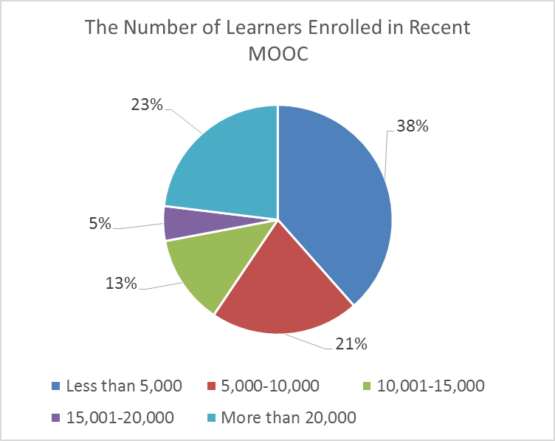
Research Context

Slide 82
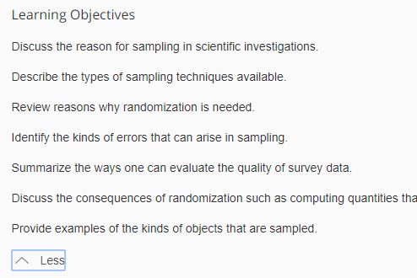
Findings RQ1
RQ #1. What are the design considerations of instructors when designing MOOCs?
Learning objectives
Assessment
Time for designing MOOC
Engaging learners
An example of learning objectives:

Slide 83
RQ1 Survey Results

Slide 84
RQ1 Interview Results
Engage learners
One instructor from US mentioned:
“I engaged people in the forum. So each week I would write a message that would be the new welcome page for the week that would say, ‘hey come to the forum and ask questions about this or come to the forum introduce yourself’... Of course, I tried to get students to feel like I was engaged with them during the videos by asking them questions and telling them to do things during the video.”

Slide 85
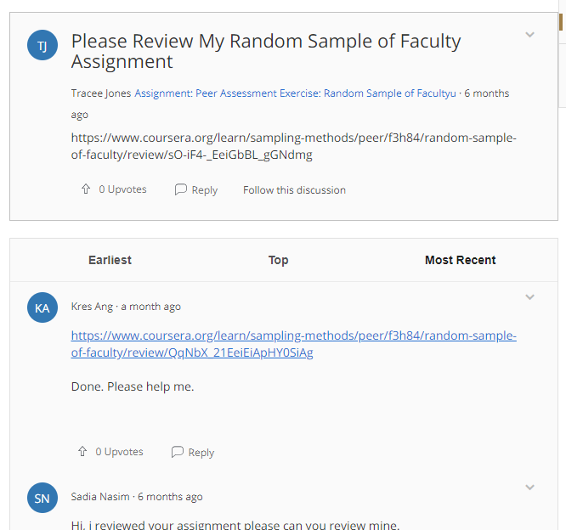
Findings RQ2
RQ #2. What challenges do instructors perceive when designing MOOCs?
Assessment methods
Engaging students’ learning
Time limitation
(Note: Above is an example of peer-assessment.)

Slide 86
RQ2 Survey Results

Slide 87
RQ2 Interview Results
Time limitation
One instructor from education subject mentioned:
“I think one of the challenges is time. It does take a lot of time to get the videos done. I did not get a course release when I was doing, and it was a side project at the same time as my regular load.”

Slide 88
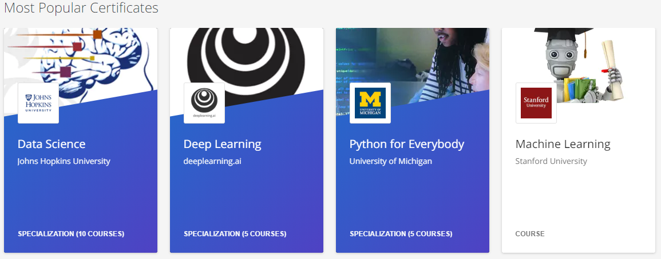
Findings RQ3
RQ #3. How do instructors address the challenges that they perceive related to MOOCs?
Explore other MOOC examples
Seek help from the platform/colleagues/institutions

Slide 89
RQ3 Survey Results

Slide 90
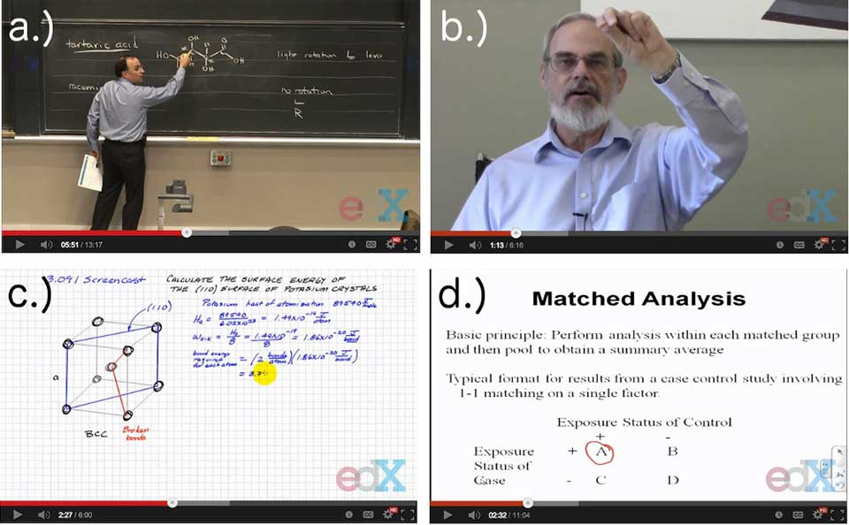
RQ3 Interview Results
Explore other MOOC examples
One MOOC instructor from the US mentioned:
“When I started making the MOOC, I could see MOOCs that other people had made. So I could see what other people did in terms of having videos with questions embedded in the videos, which I really liked.”

Slide 91
Discussion
The time limitation of creating MOOCs was the primary logistical consideration (Hew & Chung, 2014; Watson et al., 2016) and challenges.
The pedagogical factors were the primary design considerations (Watson et al., 2016) and challenges in MOOC design.
The assessment and engagement strategies are the main considerations as well as challenges.

Slide 92
Implications
For MOOC instructors
May inform them about what other instructors are most concerned with and tend to target in MOOC design as well as their efforts in addressing the possible design challenges.
For instructional designers
Guide attention to ID in the areas that MOOC instructors might need them to help in consultation.

Slide 93
Study #3 MOOCs Instructional Design to Facilitate Participants’ Self-directed Learning (Dissertation)

Slide 94
Key Terms
Self-directed learning (SDL) (Garrison, 1997)
(1) self-management
(2) self-monitoring
(3) motivation
Notes:
Garrison’s model: 3 inter-related part.

Slide 95
Research Background
Learners need self-directed learning skills and strategies to be successful in MOOCs (Halawa, Greene, & Mitchell, 2014; Littlejohn & Milligan, 2016), as there is a lack of personalized interaction with teachers.
Self-directness of a learner might vary in different learning environments which means that the learners could be more self-directed in one learning environment than another (Hiemstra, 1994).

Slide 96
Research Background
Instructional design can greatly influence students’ interaction and engagement (Garrison & Cleveland-Innes, 2005) and success in online learning (Song, Singleton, Hill, & Koh, 2004; Swan, 2001).
However, few studies have examined instructional design and the delivery of instruction using MOOCs from instructor perspectives (Margaryan et al., 2015; Watson et al., 2016); especially lacking is research on instructors’ perception of SDL and how they design MOOCs to facilitate students’ SDL.

Slide 97
Research Purpose
The purpose is to inform instructors or instructional designers and MOOC providers of the current practices of designing MOOCs to facilitate learners’ SDL.

Slide 98
Research Questions
How do MOOC instructors perceive participant SDL skills?
How do MOOC instructors perceive their facilitation of participant SDL skills?
How do instructors design and deliver MOOCs to facilitate participant SDL skills?
a. How is technology being used by MOOC instructors to support the development of participant SDL skills?
b. What technology features or functions do MOOC instructors want to have to improve their facilitation of MOOC participant SDL skills?

Slide 99
Research Design
Explanatory sequential mixed methods design (Creswell & Clark, 2017)
Pilot survey with 48 instructors
Survey
198 instructors
Review 22 MOOCs of interviewees
Interview 22 instructors
Review 22 MOOCs of interviewees
Pilot interview with 4 instructors

Slide 100
Data Collections
Survey:
Volunteer sampling (Creswell & Clark, 2017)
198 instructors responded to the survey (10% response rate)
Interview:
Homogeneous purposeful sampling (Creswell & Clark, 2017; Patton, 2002)
Maximal variation sampling (Creswell & Clark, 2017)
22 interviewees
MOOC review:
Reviewed 22 interviewees’ MOOCs

Slide 101
Pseudonym | Country | Subject area | Platform | Gender | No. of O/B | No. of M | Mode of the M
Lucas | US | Social science | edX | M | 0 | 1 | I without T
Branden | US | Education | Udacity | M | 0 | 5 or more | Self-paced
Logan | US | Literacy and Language | Coursera | M | 5 or more | 5 or more | I with T
Emma | US | Literacy and Language | Coursera | F | 2 | 1 | Self-paced
Jason | US | Science | edX | M | 1 | 1 | I with T
Jackson | US | Medicine and health | Coursera | M | 5 or more | 1 | Self-paced
Samuel | US | Education | FutureLearn | M | 4 | 3 | Self-paced
Hannah | US | Education | Blackboard | F | 5 or more | 1 | I with T
Ashley | US | Education | EdX | F | 0 | 5 or more | I with T
Andrew | UK | Art | FutureLearn | M | 0 | 3 | I with T
Emily | UK | Medicine and health | FutureLearn | F | 2 | 2 | I with T
Aiden | UK | Social science | FutureLearn | M | 0 | 1 | Self-paced
Henry | UK | Social science | FutureLearn | M | 0 | 1 | Self-paced
Joseph | UK | Medicine and health | FutureLearn | M | 1 | 1 | Self-paced
Joshua | UK | Literacy and language | FutureLearn | M | 2 | 2 | I with T
Mason | Australia | Education | Coursera | M | 5 or more | 1 | I with T
Ethan | Australia | Business | Coursera | M | 3 | 1 | I without T
Ben | Australia | Social science | edX | M | 1 | 1 | I with T
Paul | France | Computer Science | Coursera | M | 1 | 1 | I with T
Fernando | Belgium | Research methods | Blackboard | M | 5 or more | 3 | I with T
Jacob | Netherland | Science | Coursera | M | 0 | 1 | I with T
Dylan | Israel | Science | Coursera | M | 5 or more | 3 | I without T
Data Collections
Interview:

Slide 102
Data Analysis
RQs | Data Sources | Data analysis | Tools
RQ1 | Survey Interview | Descriptive statistics Content analysis (Elo & Kyngäs, 2008) | SPSS NVivo
RQ2 | Survey Interview | Descriptive statistics Content analysis | SPSS NVivo
RQ3 | Interview Course review | Content analysis Content analysis | NVivo NVivo

Slide 103
Trustworthiness
Validity survey: Experts review, think-aloud interview, and pilot test (EFA)
Reliability survey: Pilot test and internal consistency reliability (Cronbach alpha)
Triangulation: Data sources, researchers, and methods
Member checks: Interview transcriptions
Peer debriefing: Committee and colleagues
Researcher reflexivity: Constant reflection and be forthright with our positions
Thick description: Report the context, data sources, and analyses in detail
Prolonged engagement: Immerse in instructors’ MOOCs before the interview and continue reviewing the MOOCs after the interview

Slide 104
Research Context

Slide 105
RQ1 Perceptions of SDL
A majority of the MOOC instructors thought that these skills or attributes are not static, and that SDL as a set of skills can be educated or students’ personal attributes that can be changed.

Slide 106
RQ1 Interview Results
Emma’s understanding of SDL is more related to self-management and motivation. She said:
When I think about self-directed learning, I think about students managing their time and managing the coursework on their own, and how it fits into their schedules and their lives, how they interact with materials, what's going to keep them engaged.

Slide 107
RQ2 Perceptions of Facilitation of SDL
Most of MOOC instructors thought that they can intentionally or unintentionally facilitate students’ SDL.

Slide 108
RQ2 Interview Results
Ashely emphasized the importance of both instructors’ facilitation and students’ SDL skills. She said:
The participant has a lot of flexibility on how they approach the content. I mean, obviously, we have things like assignments. We have things like online forums. And there're ways that we scaffold the learning experience. But there still is a lot of choice for the learner.

Slide 109
RQ3 Strategies to Facilitate SDL
Students’ intrinsic motivation plays an important role. However, extrinsic motivation provided by the MOOCs might help transfer extrinsic motivation to intrinsic motivation.
Motivations | Strategies
Entering motivation | MOOC instructors helped students identify the needs and goals of learning and sense of achievement.
Task motivation | MOOC instructors motivated students through instruction, learning materials, feedback, and learning community.

Slide 110
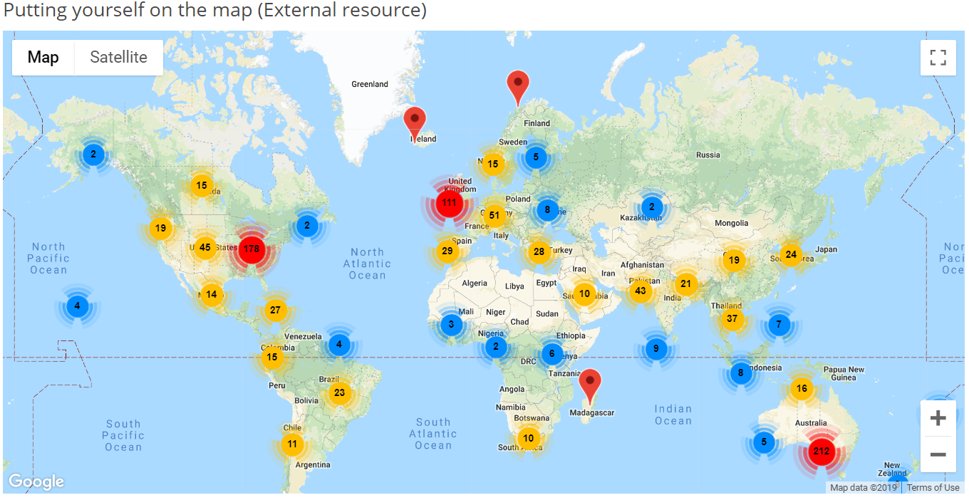
RQ3 Learning Community

Slide 111
RQ3 Strategies to Facilitate SDL
Both internal feedback and external feedback were provided to help students’ self-monitoring.
Self-monitor |  | Strategies
Internal feedback | Cognition | MOOC instructors provided quizzes for self-assessment, tutorial on technology use, learning advice, navigation of the course, progress indicators, resources, and instructional modeling, etc.
 | Meta-cog | MOOC instructors encouraged students to reflect and think critically by providing reflection questions and building learning community.
External feedback |  | MOOC instructors, teaching assistants, and peers were involved in providing external feedback.

Slide 112
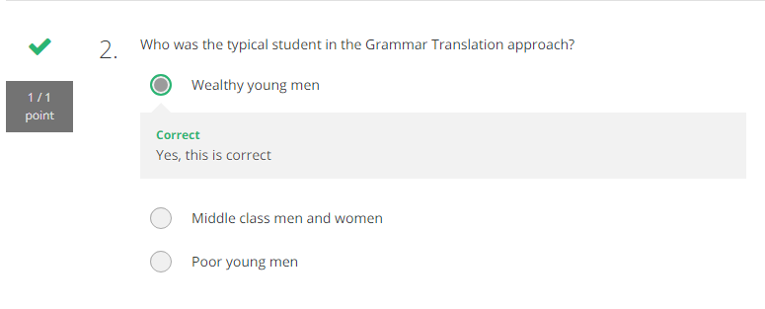
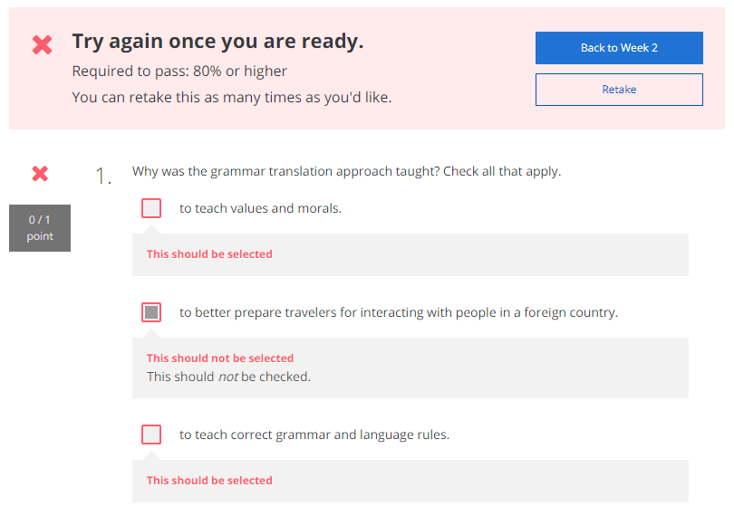
RQ3 Self-assessment

Slide 113
RQ3 Progress Indicators

Slide 114
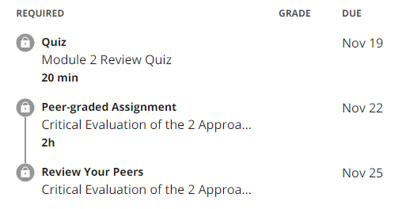
RQ3 External Feedback-Peer-assessment

Slide 115
RQ3 Strategies to Facilitate SDL
They helped students’ self-management concerning setting learning goals, time management, resources and support management although among the three elements of SDL, MOOC instructors had less control over students’ management.
Self-management | Strategies
Enactment of learning goals | Providing discussion questions, reflections, survey, and appreciation students’ learning goals.
Time management | Providing time frame, progress indicator, short learning units, and flexible timeline.
Management of resources and support | Providing flexible learning resources, peer-assessment, accessibilities, clear expectations, and short learning units.

Slide 116
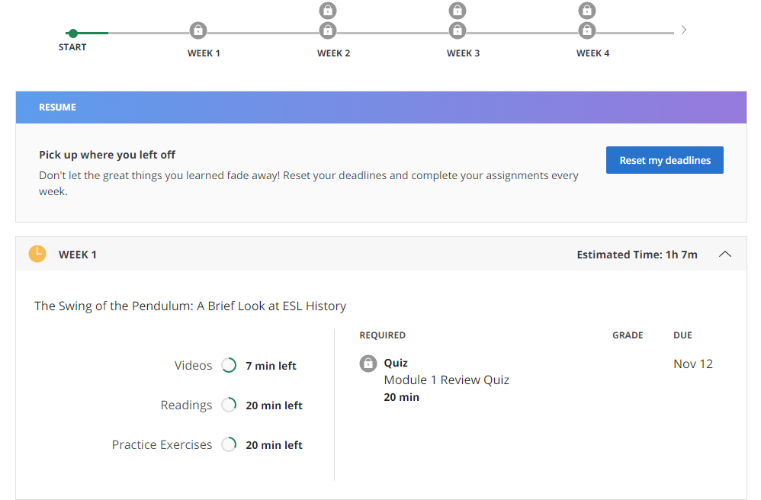
RQ3 Time Management

Slide 117
RQ3-a Tech Use for SDL
Synchronous communication technologies
Google Hangouts YouTube Live
Asynchronous communication technologies
Discussion forum Blog Slackbot Flickr
Multimedia (e.g., video and graphics)
Feedback technologies

Slide 118
RQ3-b Tech Expectations for SDL
Adaptive learning systems
Artificial intelligent systems
Learning analytics
Interactive technologies
Interaction between learners and content
Interaction among learners and other participants
Tools embedded in platforms

Slide 119
Discussion
SDL can be Changed
MOOC Instructors can Facilitate SDL
Strategies to Facilitate SDL: A variety of strategies can be used to facilitate student SDL skills in terms of motivation, self-monitor, and self-management.
Tech for SDL: Tech plays an important role in facilitating SDL skills.
Tech expectations: Adaptive learning systems, artificial intelligent systems, and learning analytics were expected to have to support SDL.

Slide 120
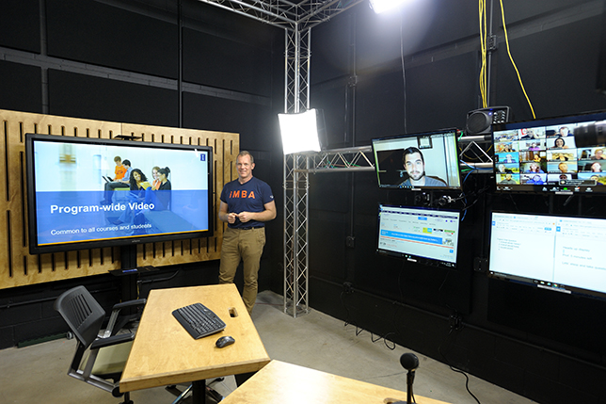
Implications
For MOOC instructors and Instructional Designers
Build learning community
Inspire intrinsic motivation
Personalize learning
For MOOC providers
Create a personalized learning environment
Provide learning analytics to support learning and teaching

Slide 121
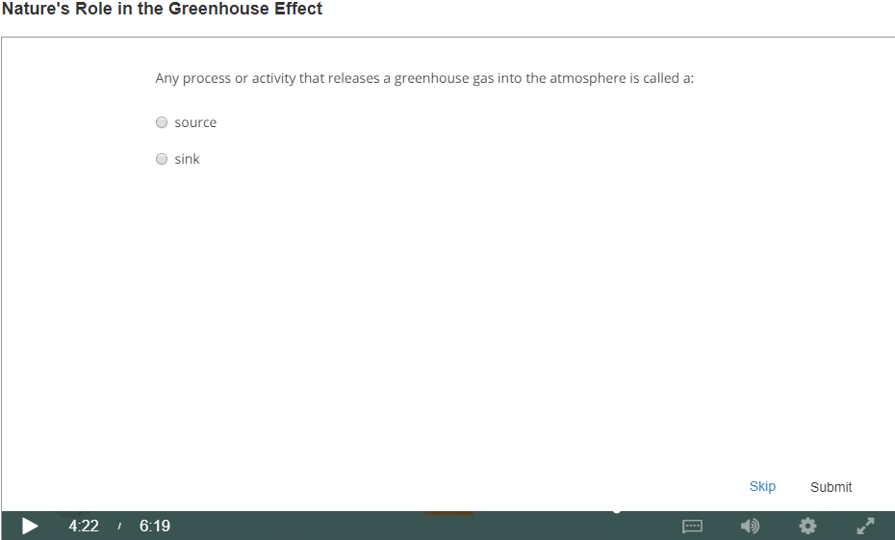
Top 10 Strategies to Facilitate SDL in MOOCs
Helping students set their own learning goals;
Building learning community;
Offering immediate feedback;
Embedding quizzes for self-assessment;
Providing progress indicators;
Providing reflection questions;
Designing short learning units;
Providing flexible timelines;
Highlighting estimated time frames;
Making available optional learning materials.

Slide 122
Other Related MOOC Studies
Sari, A. R., Bonk, C. J., & Zhu, M. (in revision). MOOC Instructor Designs and Challenges: What can be Learned from Existing MOOCs in Indonesia and Malaysia? Asia Pacific Education Review.
Zhu, M., Bonk, C. J., & Sari, A. (in review). MOOC Instructor Motivations, Innovations, and Designs: Surveys, Interviews, and Course Reviews. Canadian Journal of Learning & Tech.
Doo, M., Tang, Y., Bonk, C. J., & Zhu, M. (in review). A Mixed Methods Look at Motivation and Career Development of MOOC Instructors. Australasian Journal of Educ. Technology.
Bonk, C. J., Sabir, N., Sari, A., Zhu, M., Xu., S., & Kim, M. (in preparation). MOOC instructors’ efforts to address learner diversity in design and implementation.
Zhu, M., Sari, A. R., & Bonk, C. J. (in preparation). Systematic review of MOOC research from 2012-2019. (Intended for special issue of ETR&D)
Doo, M., Zhu, M., Bonk, C. J., & Tang, Y. (data collect). MOOC instructor engagement.
Zhu, M., & Bonk, C. J. (data collect). MOOC Student Perceptions of Effective SDL Strats.

Slide 123
Tired of MOOCs…?

Slide 124
Do we have time for another study?

Slide 125
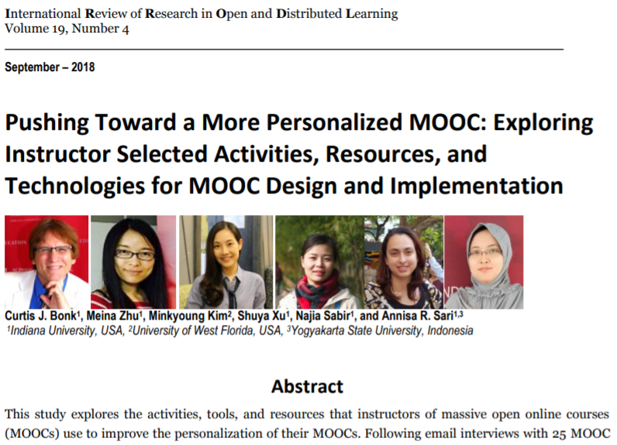
Other Related MOOC Studies

Slide 126
Figure 1. MOOC instructor departmental or primary discipline affiliations (n=150)

Slide 127
Figure 3 and 4. Effort placed on meeting unique learner needs when designing and delivering most recent MOOC (Note: on a scale of 1 (low) to 10 (high) (n=144)

Slide 128
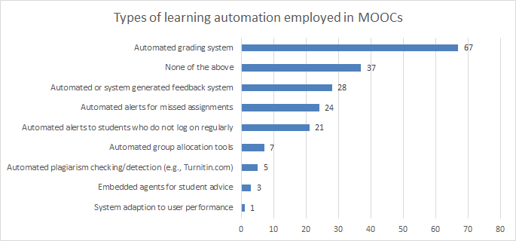
Figure 6. Number of MOOCs that offer different types of learning system automation and adaptation (n=127)

Slide 129
Figure 9: MOOC instructors (n=133) instructional practices to address cultural diversity

Slide 130
Table 1. Instructional Practices of MOOC Instructors to Address the Variety of Student Competencies and Needs (n=142)

Slide 132
Discussion, Significance, and Conclusion

Slide 133
30+ Ways Learning is Changing: Recapping the Three Mega Trends: Engagement, Access, and Customization

Slide 134
Thank you! Any Questions?
Curtis Bonk: cjbonk@Indiana.edu
Meina Zhu: meinzhu@iu.edu
Slides and Proceedings Paper at TrainingShare.com: http://www.trainingshare.com (go to “Archived Talks”)

