Slide 1
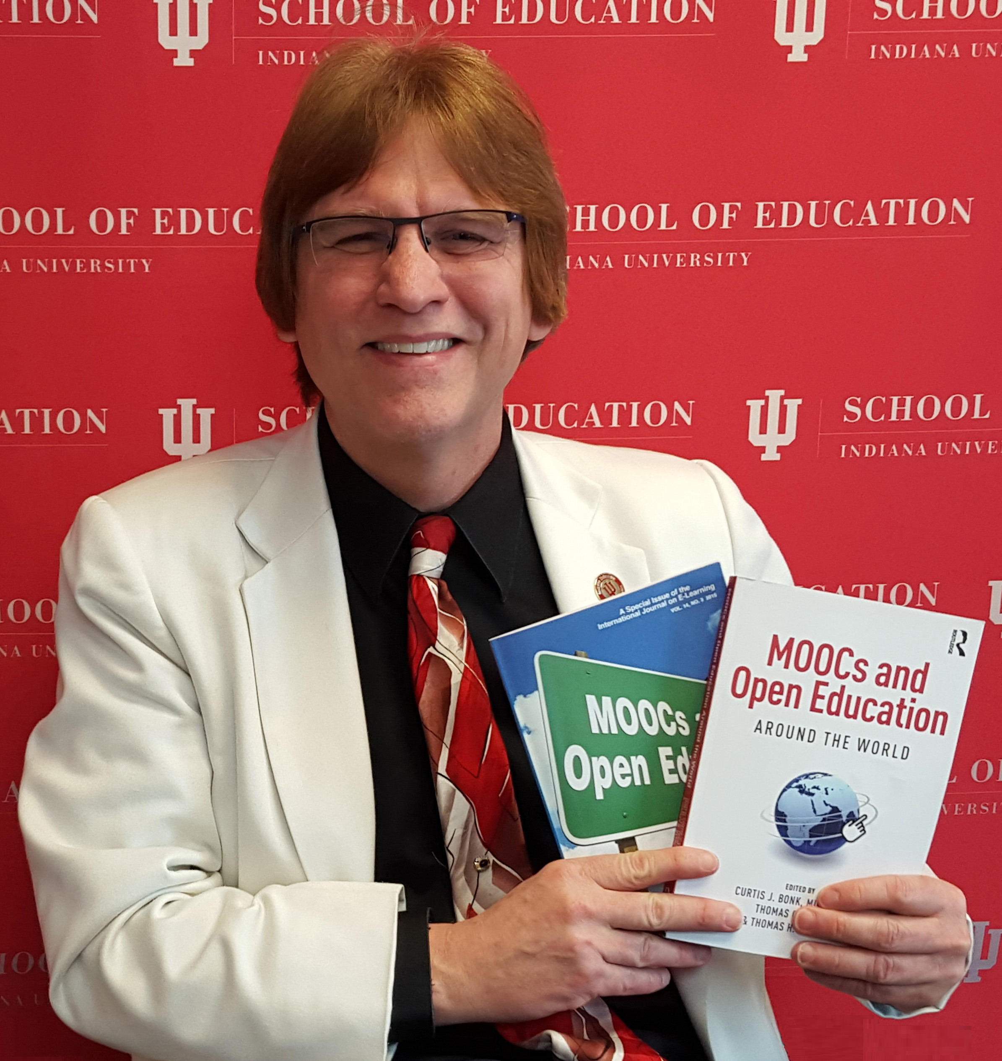
Foregrounding Online Instructor Preparation and Professional Learning (The 4 E’s of Research During the Pandemic: Experimentation, Engagement, Emotions, and Innovative Educational Delivery: Online Teaching and Learning SIG)
Discussant
Curtis J. Bonk, Ph.D., Indiana University
cjbonk@indiana.edu
Notes:
All
1

Slide 3
Key Points

Slide 4
Key Points: General
All: There are millions of teachers taking on new roles and we need to understand what happened and what works.
GMU (and all): And there is a ton of data at your fingertips
GMU: Data is out there awaiting your interesting questions
GMU: There is a need for additional research on global education and self-directed learning.
GMU: Need to team up for economies of scale. Assemble a team which is interested and motivated in your topic and has expertise.

Slide 5
Key Points: General
Enilda and Nadia (Tampa and OSU): Don’t wait until AERA to finish your papers; if possible, submit before the conference.
GMU: New learning environments such as MOOC camps.
You need to publish a paper on MOOC camp structures.
Smart: Build on the shoulders of giants (motivation and self-efficacy: Bandura, Ames, Wigfield, Ormrod, Pintrich, Eccles, etc.) (technology: Richardson, Truman-Davis, Picciano, Seaman, etc.)

Slide 6
Key Points: Instruments
Smart. For rapid info, use or modify existing schemes and instruments (e.g., the Online Teaching Motivation Scale)
COVID Team: Metacognitive Technological Pedagogical Content Knowledge (M-PACK)
GMU: Academic Community of Engagement (ACE) Framework from Jered Borup

Slide 7
Key Points: Emotional
Smart (and Tampa and OSU): Teachers must be supported by administration and institutional support.
McGill: Effective teaching involves and wide range of emotions. Life is full of emotions, but perhaps no time like now.
COVID Team: Fatigue, anxiety, stress, sitting all day—physical pain (there is a need for flexibility, need to share practices, student centered where and when possible.
McGill: Emotional experiences during the pandemic need to be better understood: What did we do? What do we do now? Will it continue into the future?

Slide 8
Key Points: Engagement
GSU (and others): What is engagement and how can we measure it? Whether it is affective, behavioral, or cognitive.
GSU (and others): The increasing focus on the affective side; the psycho-social emotional needs.
GSU (and others): Teachers needs skills in affective engagement like developing relationships, facilitating communication, and instilling excitement for learning.

Slide 9
Key Points: New Educational Training Models
McGill: Should we change the way that teachers are trained? If so, how so?
Tampa and OSU: We have been jump started toward transformative change or have the potential for it.
Tampa and OSU: Digital pedagogy has risen in importance. Now how do we measure it and enhance it?
Tampa and OSU: What are the new instructional delivery models for this digital age?
Tampa and OSU: This is often not experimental nor creative pedagogy, but simply (or not so simple) adaptation to the conditions.
Tampa and OSU: We are reactive creatures. How can we be trained to be more proactive?

Slide 10
Key Points: New Educational Models
GMU: Be creative somewhere in your work (bMOOCs)
GMU: Stronger communities come from the blends of virtual and FTF
GMU: Loads of interesting and important language learning from MOOCs and open ed during pandemic.

Slide 11
Key Points: New Models
GMU (and others): Need new models of educational delivery; which includes volunteers, facilitators, and informal learning.

Slide 12
Key Points: Need for Training
Tampa and OSU (and all): Read this paper if you’re an online learning trainer or a teacher and learning center staff member or director.
Tampa and OSU (and all): Quick hits not extended reflections—webinars, workshops, colleague advice, friends, social media searches, etc. How to extend and connect all that in a COP/COL?
Tampa and OSU (and all) need create innovative and transformative learning experiences that impact instructors and students’ digital practices.
Tampa and OSU (and all) lack of clear guidelines.

Slide 13
Key Points: Engaging Pedagogy and Models
COVID Team (and all teams): How were pedagogical approaches impacted or affected by the pandemic? How comfortable with new models and tools? Can these practices and ideas and new models transfer to a post-pandemic age?

